Slide 1
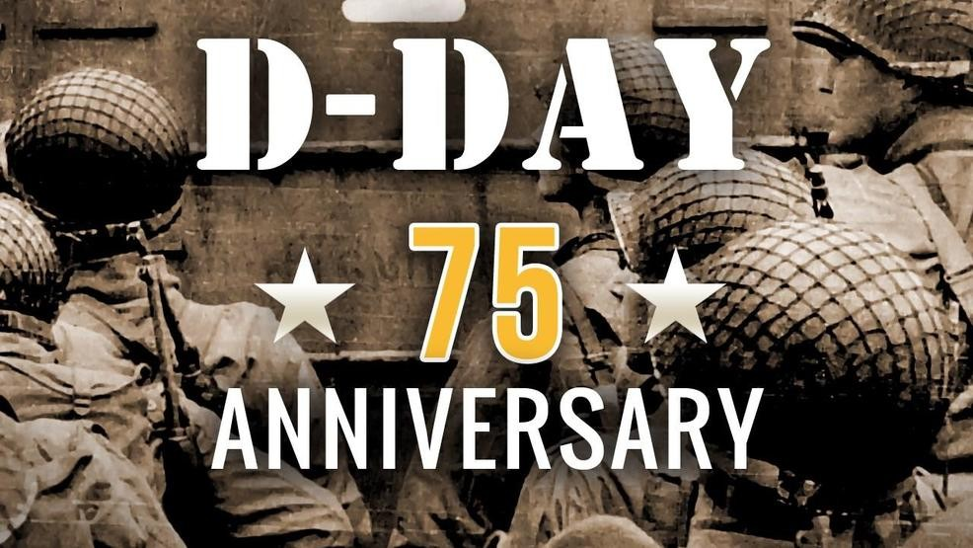
West Main Anchor
WHEN YOU PRAY, PLEASE REMEMBER:
The Helmick family, Riley Helmick, Mariah Leach, Melvin Krumrei – health concerns, Denise Jurkovich – Cancer treatments, Bonnie Lewis’ sister Janet Hudson – Emerald Pointe, Vivian’s sister Margaret– Leukemia, Kayla Eagon – to remain cancer free, Mark Yurina – ongoing struggles with shoulder, our men out preaching. Please remember those who are struggling with declining health, or are battling their own spiritual battles. Please remember the lost of our fold and always be on the watch for a way to encourage them.
*Pray for those fighting battles they are not comfortable sharing*
Hebrews 6:19a Which hope we have as an anchor of the soul, both sure and steadfast, and which entereth into that within the veil
June Birthdays: 18th Cindy Messenger, 24th Kendall Lucas, 30th June Butler
Next Lady’s Bible Study Jul 1st – 6:45 pm
Next Men’s Bible Study Jun 30th – 4:30 pm
Personal Work Group 1 Meets Tonight
Our country remembered this past Thursday those who fought and gave their lives for our religious freedom 75 years ago.
Duty Roster | Sunday AM | Sunday PM | Wednesday 6/12
Announcements | Jeff Lewis | Jeff Lewis | Matt Palmer
Opening Prayer | Rick Lucas | Jim Thornburg | Jamie Helmick
Song Leader | Darren Leach | Jacob Leach | Jeff Lewis
Preside Table | Nathan Anderson | Jeff Lewis | --
Assist - Bread Fruit of Vine Offering Bulletins | Cary Leach Gary Lucas Jr Mike Anderson Dale Leach | -- | --
Start Sound & Projector | Cole Palmer | Cole Palmer | Cole Palmer
Visitor Cards | Jeff Lewis | Jeff Lewis | Jeff Lewis
Scripture Reading | Gary Lucas | Ethan Leach | --
Lesson / Inv. | Sam Leach | Ty Leach | Jared Kernen
Closing Prayer | Matt Palmer | Melvin Krumrie | Darren Leach
WEST MAIN STREET CHURCH OF CHRIST 6-9-2019
237 West Main Street, Barnesville, Ohio 43713
Visiting with us?
Please fill out a visitors card and put it in the collection plate when it is passed or hand it off to a member so we may have record of your attendance. Please come again!
Please visit our website for a host of helpful resources 🙂
www.barnesvillecoc.com
Meeting Times
Sunday: Bible Study - 9:30am, Worship - 10:30am, 6:00pm
Wednesday: Bible Study - 7:00pm
Any Questions? Please Let Us Know:
The Elders: Dale Leach - 484-4810, Jeff Lewis – 425-9269, & Gary Lucas - 425-4484
Deacons: Darren Leach, Matt Palmer, Rick Lucas
Study the Bible
Would you like to be more familiar with the scriptures? Ask us about our Bible correspondence program.

Slide 2
“About Face!”
Glen Elliott
Across:
2. Mother of John the Baptist 4. Man whom Jesus raised from the dead 7. The earthly father of Jesus 10. Short tax collector 11. Tax collector who wrote became a disciple 12. Temple prophetess 14. He found no guilt in Jesus, yet sentenced him to death 17. Father of John the Baptist 19. Doctor and New Testament writer 21. The disciple who was also called Peter 22. Betrayer of Jesus (2 wds) 23. Blind beggar healed by Jesus 24. The Way, the Truth, and the Life
Down:
1. The mother of Jesus 3. Father of disciples James and John 5. Peter's brother 6. The forerunner of Jesus (3 wds) 8. The tempter 9. Man who issued decree for census (2 wds) 13. He asked, "How can a man be born again?" 14. The disciple who called Nathanael to follow Jesus 15. Writer of the second gospel 16. Mary's very busy sister 18. He had John the Baptist beheaded 20. Official whose daughter was healed by Jesus
Among the many commands a fresh recruit might hear from his or her drill sergeant are the words: “About face!” Like snapping to attention or giving a proper salute, doing an about face requires practice and precision. Otherwise, the pivot may throw one off-balance resulting in embarrassing, even painful consequences.
The spiritual equivalent to an “about face” is repentance. Repentance is a change of mind resulting in a change of life. While repentance is the result of “godly sorrow” (2 Cor. 7:10); sorrow alone is not repentance. While the Lord knows “the thoughts and intentions of the heart” (Hb. 4:12 cf. Ps. 139:1-4); as human beings, we are incapable of accurately gauging what takes place in the heart of those making a claim to repentance. The best we can do is observe, in the conduct of others, the evidence or lack of evidence of genuine repentance (Mt. 3:8). A spiritual “about face” sends one in the opposite direction. Before repentance one had turned away from the Lord; but, now, with true repentance, one has set his or her face toward God.
Too many practice sloppy repentance. They feel uncomfortable, even sorrowful, about their sins. Some even respond to the invitation at the end of a Sunday morning sermon. In many cases, this is a good start. But, repentance involves so much more than that. One must also follow-through, making an “about face” and moving forward in the direction that God has revealed in His word. This is where the church must show ongoing support through the hard work of making these difficult changes in life.
Repentance is God’s most difficult command. We must not compromise where God has spoken. We do no one a favor by watering down God’s expectations. Diverting people away from genuine repentance because it is difficult or uncomfortable keeps them away from the blessings of forgiveness and everlasting life. Jesus said, “unless you repent, you will all likewise perish” (Lk. 13:3). But, the Lord “is patient toward you, not wishing for any to perish but for all to come to repentance” (2 Pet. 3:9). The kindness of God should lead “us to repentance” (Rm. 2:4). But, ultimately, we are the ones who must do an “about face.”

