Slide 1
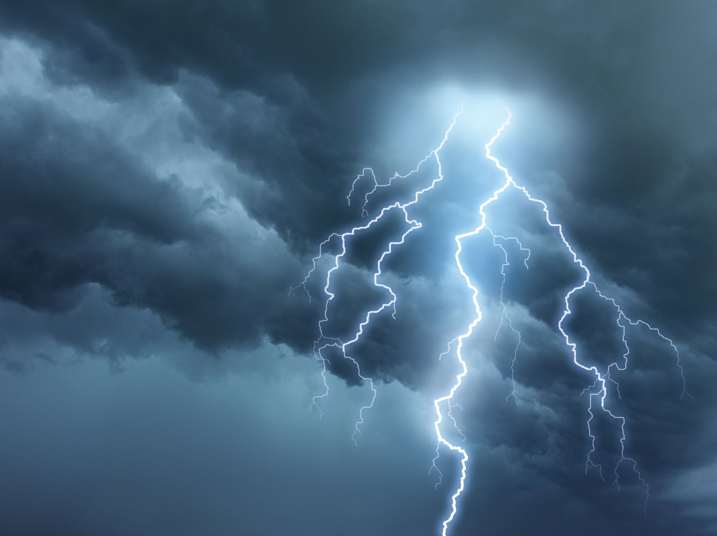
Humble Obedience
Do I have what it takes?

Slide 2
Hebrews 4:12-13 (-15)
For the word of God is quick, and powerful, and sharper than any two-edged sword, piercing even to the dividing asunder of soul and spirit, and of the joints and marrow, and is a discerner of the thoughts and intents of the heart. 13 Neither is there any creature that is not manifest in his sight: but all things are naked and opened unto the eyes of him with whom we have to do.
Notes:
Jesus the Great High Priest
Heb 4:14 Seeing then that we have a great high priest, that is passed into the heavens, Jesus the Son of God, let us hold fast our profession.
Heb 4:15 For we have not an high priest which cannot be touched with the feeling of our infirmities; but was in all points tempted like as we are, yet without sin. 16 Let us therefore come boldly unto the throne of grace, that we may obtain mercy, and find grace to help in time of need.

Slide 3
1Corinthains 4:9-14 For I think that God hath set forth us the apostles last, as it were appointed to death: for we are made a spectacle unto the world, and to angels, and to men. 10 We are fools for Christ's sake, but ye are wise in Christ; we are weak, but ye are strong; ye are honourable, but we are despised. 11 Even unto this present hour we both hunger, and thirst, and are naked, and are buffeted, and have no certain dwelling place; 12 And labour, working with our own hands: being reviled, we bless; being persecuted, we suffer it: 13 Being defamed, we intreat: we are made as the filth of the world, and are the offscouring of all things unto this day. 14 I write not these things to shame you, but as my beloved sons I warn you.

Slide 4
Expectation?
Matthew 23:5-7
They do all their deeds to be seen by others. For they make their phylacteries broad and their fringes long, 6 and they love the place of honor at feasts and the best seats in the synagogues 7 and greetings in the marketplaces and being called rabbi by others.
2 Corinthians 10:12
For we dare not make ourselves of the number or compare ourselves with some that commend themselves: but they measuring themselves by themselves, and comparing themselves among themselves, are not wise.
Notes:
We may not identify well with either of these accounts…
But we certainly welcome the fellowship of the saints.
-We just need to be sure this it is not growing into what is listed in these verses.

Slide 5
reality
Philippians 1:27-30
Only let your manner of life be worthy of the gospel of Christ, so that whether I come and see you or am absent, I may hear of you that you are standing firm in one spirit, with one mind striving side by side for the faith of the gospel, 28 and not frightened in anything by your opponents. This is a clear sign to them of their destruction, but of your salvation, and that from God. 29 For it has been granted to you that for the sake of Christ you should not only believe in him but also suffer for his sake, 30 engaged in the same conflict that you saw I had and now hear that I still have.

Slide 6
Suffering by example
Peter & John
Act 4:21 So when they had further threatened them, they let them go, finding nothing how they might punish them, because of the people: for all men glorified God for that which was done.
Notes:
Peter & John

Slide 7
Suffering by example
Peter & Apostles
Act 5:17-18 Then the high priest rose up, and all they that were with him, (which is the sect of the Sadducees,) and were filled with indignation, 18 And laid their hands on the apostles, and put them in the common prison.
33 When they heard that, they were cut to the heart, and took counsel to slay them.
40-41 And to him they agreed: and when they had called the apostles, and beaten them, they commanded that they should not speak in the name of Jesus, and let them go. 41 And they departed from the presence of the council, rejoicing that they were counted worthy to suffer shame for his name.
Notes:
Peter & other Apostles

Slide 8
Suffering by example
Stephen
Acts 6:8 And Stephen, full of faith and power, did great wonders and miracles among the people.
10 And they were not able to resist the wisdom and the spirit by which he spake.
15 And all that sat in the council, looking stedfastly on him, saw his face as it had been the face of an angel.
Acts 7:54 When they heard these things, they were cut to the heart, and they gnashed on him with their teeth.
58 And cast him out of the city, and stoned him: and the witnesses laid down their clothes at a young man's feet, whose name was Saul.
Notes:
Peter & other Apostles

Slide 9
Suffering by example
Paul
2 Corinthians 11:23b-28
in labours more abundant, in stripes above measure, in prisons more frequent, in deaths oft. 24 Of the Jews five times received I forty stripes save one. 25 Thrice was I beaten with rods, once was I stoned, thrice I suffered shipwreck, a night and a day I have been in the deep; 26 In journeyings often, in perils of waters, in perils of robbers, in perils by mine own countrymen, in perils by the heathen, in perils in the city, in perils in the wilderness, in perils in the sea, in perils among false brethren; 27 In weariness and painfulness, in watchings often, in hunger and thirst, in fastings often, in cold and nakedness. 28 Beside those things that are without, that which cometh upon me daily, the care of all the churches.
Notes:
Peter & other Apostles

Slide 10
The Doctrine of Jesus Christ
Matthew 4:17
From that time Jesus began to preach, and to say, Repent: for the kingdom of heaven is at hand.
Acts 2:22-24 Peter, ”Ye men of Israel, hear these words; Jesus of Nazareth, a man approved of God among you by miracles and wonders and signs, which God did by him in the midst of you, as ye yourselves also know: 23 Him, being delivered by the determinate counsel and foreknowledge of God, ye have taken, and by wicked hands have crucified and slain: 24 Whom God hath raised up, having loosed the pains of death: because it was not possible that he should be holden of it.
32 This Jesus hath God raised up, whereof we all are witnesses.
36 Therefore let all the house of Israel know assuredly, that God hath made that same Jesus, whom ye have crucified, both Lord and Christ.
Acts 26:23
Paul, “That Christ should suffer, and that he should be the first that should rise from the dead, and should shew light unto the people, and to the Gentiles.”
Notes:
Jesus Rejected at Nazareth
Luk 4:16 And he came to Nazareth, where he had been brought up: and, as his custom was, he went into the synagogue on the sabbath day, and stood up for to read.
Luk 4:17 And there was delivered unto him the book of the prophet Esaias. And when he had opened the book, he found the place where it was written,
Luk 4:18 The Spirit of the Lord is upon me, because he hath anointed me to preach the gospel to the poor; he hath sent me to heal the brokenhearted, to preach deliverance to the captives, and recovering of sight to the blind, to set at liberty them that are bruised,
Luk 4:19 To preach the acceptable year of the Lord.
Luk 4:20 And he closed the book, and he gave it again to the minister, and sat down. And the eyes of all them that were in the synagogue were fastened on him.
Luk 4:21 And he began to say unto them, This day is this scripture fulfilled in your ears.
Teach Sound Doctrine
Tit 2:1 But speak thou the things which become sound doctrine:
Tit 2:2 That the aged men be sober, grave, temperate, sound in faith, in charity, in patience.
Tit 2:3 The aged women likewise, that they be in behaviour as becometh holiness, not false accusers, not given to much wine, teachers of good things;
Tit 2:4 That they may teach the young women to be sober, to love their husbands, to love their children,
Tit 2:5 To be discreet, chaste, keepers at home, good, obedient to their own husbands, that the word of God be not blasphemed.
Tit 2:6 Young men likewise exhort to be sober minded.
Tit 2:7 In all things shewing thyself a pattern of good works: in doctrine shewing uncorruptness, gravity, sincerity,
Tit 2:8 Sound speech, that cannot be condemned; that he that is of the contrary part may be ashamed, having no evil thing to say of you.
Tit 2:9 Exhort servants to be obedient unto their own masters, and to please them well in all things; not answering again;
Tit 2:10 Not purloining, but shewing all good fidelity; that they may adorn the doctrine of God our Saviour in all things.
Tit 2:11 For the grace of God that bringeth salvation hath appeared to all men,
Tit 2:12 Teaching us that, denying ungodliness and worldly lusts, we should live soberly, righteously, and godly, in this present world;
Tit 2:13 Looking for that blessed hope, and the glorious appearing of the great God and our Saviour Jesus Christ;
Tit 2:14 Who gave himself for us, that he might redeem us from all iniquity, and purify unto himself a peculiar people, zealous of good works.
Tit 2:15 These things speak, and exhort, and rebuke with all authority. Let no man despise thee.

Slide 11
The Doctrine of Jesus Christ
Act 4:12
Neither is there salvation in any other: for there is none other name under heaven given among men, whereby we must be saved.

Slide 12
The Doctrine of Jesus Christ
Luke 13:3 (&6)
I tell you, Nay: but, except ye repent, ye shall all likewise perish.

Slide 13
The Doctrine of Jesus Christ
Mark 16:15-16
And he said unto them, Go ye into all the world, and preach the gospel to every creature. 16 He that believeth and is baptized shall be saved; but he that believeth not shall be damned.

Slide 14
Suffering by example
Jesus Christ
Hebrews 5:8-10
Though he were a Son, yet learned he obedience by the things which he suffered; 9 And being made perfect, he became the author of eternal salvation unto all them that obey him; 10 Called of God an high priest after the order of Melchisedec.
Notes:
It was necessary even for Jesus to suffer so that He might minister unto us when we suffer to fulfill:
Heb 4:15 For we have not an high priest which cannot be touched with the feeling of our infirmities; but was in all points tempted like as we are, yet without sin.

Slide 15
Suffering has purpose
Romans 5:3-8
And not only so, but we glory in tribulations also: knowing that tribulation worketh patience; 4 And patience, experience; and experience, hope: 5 And hope maketh not ashamed; because the love of God is shed abroad in our hearts by the Holy Ghost which is given unto us. 6 For when we were yet without strength, in due time Christ died for the ungodly. 7 For scarcely for a righteous man will one die: yet peradventure for a good man some would even dare to die. 8 But God commendeth his love toward us, in that, while we were yet sinners, Christ died for us.

Slide 16
It will be worth it!
Romans 8:35-39
Who shall separate us from the love of Christ? shall tribulation, or distress, or persecution, or famine, or nakedness, or peril, or sword? 36 As it is written, For thy sake we are killed all the day long; we are accounted as sheep for the slaughter. 37 Nay, in all these things we are more than conquerors through him that loved us. 38 For I am persuaded, that neither death, nor life, nor angels, nor principalities, nor powers, nor things present, nor things to come, 39 Nor height, nor depth, nor any other creature, shall be able to separate us from the love of God, which is in Christ Jesus our Lord.

