Slide 1
Exercising Control
Galations 6:1-consider thyself

Slide 2
Getting Sick- Can Be OUT OF YOUR CONTROL. YOU CAN TAKE PRECAUTIONARY STEPS BUT ULTIMATELY ONCE YOU GET IT THERE’S NOT MUCH YOU CAN DO.
This Photo by Unknown Author is licensed under CC BY-SA-NC

Slide 3
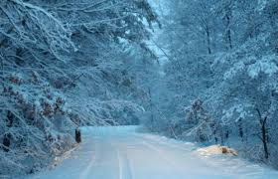
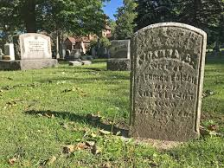
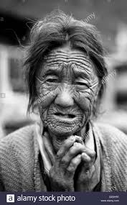
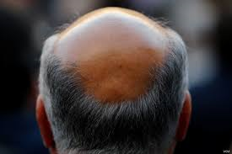
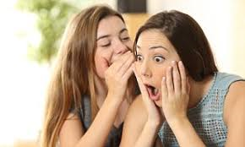
THINGS OUT OF YOUR CONTROL

Slide 4
Things in your control
Philippians 2:20-21 ²⁰ For I have no one like-minded, who will sincerely care for your state. ²¹ For all seek their own, not the things which are of Christ Jesus.
Works of the flesh-Galations 5: 19-21 19 Now the works of the flesh are evident, which are: [a]adultery, [b]fornication, uncleanness, lewdness, 20 idolatry, sorcery, hatred, contentions, jealousies, outbursts of wrath, selfish ambitions, dissensions, heresies, 21 envy, [c]murders, drunkenness, revelries, and the like; of which I tell you beforehand, just as I also told you in time past, that those who practice such things will not inherit the kingdom of God.
FRUITS OF THE SPIRIT-Galatians 5:22-24 ²² But the fruit of the Spirit is love, joy, peace, longsuffering, kindness, goodness, faithfulness, ^{23 [a]}gentleness, self-control. Against such there is no law. ²⁴ And those who are Christ’s have crucified the flesh with its passions and desires

Slide 5
WE ARE TO BEAR OUR OWN LOAD
Galatians 6:4-6 ⁴ But let each one examine his own work, and then he will have rejoicing in himself alone, and not in another. ⁵ For each one shall bear his own load.
Philippians 2:12-13 ¹² Therefore, my beloved, as you have always obeyed, not as in my presence only, but now much more in my absence, work out your own salvation with fear and trembling; ¹³ for it is God who works in you both to will and to do for His good pleasure.
OUR NATURE
Ephesians 2:1-3 2 And you He made alive, who were dead in trespasses and sins, ² in which you once walked according to the ^{[a]}course of this world, according to the prince of the power of the air, the spirit who now works in the sons of disobedience, ³ among whom also we all once conducted ourselves in the lusts of our flesh, fulfilling the desires of the flesh and of the mind, and were by nature children of wrath, just as the others.
PUT OFF OLD MAN-EPH 4:22-24 PUT ON THE NEW- COL 3:12-15

Slide 6
CONTROLLING TONGUE
Ephesians 4:25-32 ²⁵ Therefore, putting away lying, “Let each one of you speak truth with his neighbor,” for we are members of one another. ²⁶ “Be angry, and do not sin”: do not let the sun go down on your wrath, ²⁷ nor give ^{[a]}place to the devil. ²⁸ Let him who stole steal no longer, but rather let him labor, working with his hands what is good, that he may have something to give him who has need. ²⁹ Let no corrupt word proceed out of your mouth, but what is good for necessary ^{[b]}edification, that it may impart grace to the hearers. ³⁰ And do not grieve the Holy Spirit of God, by whom you were sealed for the day of redemption. ³¹ Let all bitterness, wrath, anger, ^{[c]}clamor, and evil speaking be put away from you, with all malice. ³² And be kind to one another, tenderhearted, forgiving one another, even as God in Christ forgave you.
James 3:2-11 ² For we all stumble in many things. If anyone does not stumble in word, he is a ^{[a]}perfect man, able also to bridle the whole body. ^{3 [b]}Indeed, we put bits in horses’ mouths that they may obey us, and we turn their whole body. ⁴ Look also at ships: although they are so large and are driven by fierce winds, they are turned by a very small rudder wherever the pilot desires. ⁵ Even so the tongue is a little member and boasts great things.
See how great a forest a little fire kindles! ⁶ And the tongue is a fire, a world of ^{[c]}iniquity. The tongue is so set among our members that it defiles the whole body, and sets on fire the course of ^{[d]}nature; and it is set on fire by ^{[e]}hell. ⁷ For every kind of beast and bird, of reptile and creature of the sea, is tamed and has been tamed by mankind. ⁸ But no man can tame the tongue. It is an unruly evil, full of deadly poison. ⁹ With it we bless our God and Father, and with it we curse men, who have been made in the ^{[f]}similitude of God. ¹⁰ Out of the same mouth proceed blessing and cursing. My brethren, these things ought not to be so. ¹¹ Does a spring send forth fresh water and bitter from the same opening?

Slide 7
CONTROL WHAT YOU SAY AND WHAT YOU DON’T SAY
GOSSIPING, PUTTING OTHERS DOWN, BRAGGING, MANIPULATING, FALSE TEACHING, EXAGGERATING, LYING, COMPLAINING-PHIL 2:14
COMPLAIN GOING THROUGH THE DRIVE THROUGH OR AT A STOP LIGHT

Slide 8
SEASONED WITH SALT- COL 4:6 ESTEEM OTHERS- Phil 2:3-4 every tongue will confess- phil 2:11 out of the abundance of the heart the mouth speaks-matt 12:34 Exercise Job’s Control

Slide 9
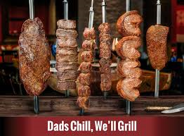
Controlling gluttony
Daniel 1-young man taken captive in a strange place speaking strange language. He didn’t eat of the kings food. Vs 8 he purposed in his heart. They took away the others food.
Texas de brazil
Phil 3: 18-WHOSE gOD is their belly
Prov 23:2 “put a knife to your throat if you are a man given to appetite
Prov 23:21 “for the drunkard and the glutton will come to poverty.
Rom 13:14 “but put on the lord jesus Christ, and make no provision for the flesh, to fulfill its lusts.

Slide 10
Controlling lusts
Ephesians 5:3-7 ³ But fornication and all uncleanness or covetousness, let it not even be named among you, as is fitting for saints; ⁴ neither filthiness, nor foolish talking, nor coarse jesting, which are not fitting, but rather giving of thanks. ⁵ For ^{[a]}this you know, that no fornicator, unclean person, nor covetous man, who is an idolater, has any inheritance in the kingdom of Christ and God. ⁶ Let no one deceive you with empty words, for because of these things the wrath of God comes upon the sons of disobedience. ⁷ Therefore do not be partakers with them.
Colossians 3:5-7
⁵ Therefore put to death your members which are on the earth: fornication, uncleanness, passion, evil desire, and covetousness, which is idolatry. ⁶ Because of these things the wrath of God is coming upon the sons of disobedience, ⁷ in which you yourselves once walked when you lived in them.
1 Thessalonians 4:3-5 ³ For this is the will of God, your sanctification: that you should abstain from sexual immorality; ⁴ that each of you should know how to possess his own vessel in sanctification and honor, ⁵ not in passion of lust, like the Gentiles who do not know God;
Women are beautiful, god made them that way. Adam married the most beautiful woman on earth.
Natural( Rom 1:26)
Paul told timothy(34ys of age) to flee youthful lusts 2 tim 2:22
Joseph literally ran away(gen 39:7-14) she tried day by day
Women adorn themselves-1 tim 2:9-10
Jesus said if you’re right eye causes you to sin pluck it out.

Slide 11
Controlling the child
There is no rule book. All are different. Every situation is different. Only have god’s word and my own experience.
Paul tells elders to keep children in submission with all reverence. Tells deacons rule their children well. 1 tim 3:4-5, 12
Children need discipline. They don’t make the rules. Guess what? They will still love you.
Don’t put them in precarious situations(dances, out late, boyfriends/girlfriends too early, wrong friends-only takes 1-2 tim 2:22)
Mark 9: Jesus in Capernaum said whoever cause one of these children to stumble it would be better if a millstone was hung around his neck.
Prov. 13:24-sparing rod hate his son. Disciplines promptly
Prov 23:13 do not withhold correction, he will not die

Slide 12
Controlling the child
Children are foolish- prov 22:15. “bound up. “rod of correction driving it far from him”
2 tim 3:1-5(lovers of themselves, disobedient to parents)
Give a kid an inch, take it a mile. You can have one candy bar, they want two. Out til 9, they want out til 10. have 2 friends over, they want 3.
Well I know my kids and you have to trust them sometime. Dress them in white and have them walk in a coal mine. Letting a dog loose in the yard. Letting children drive the car. Don’t take your foot off the gas!

Slide 13
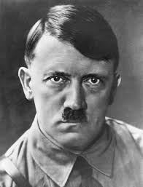
Let me control the textbooks and I will control the state. Give me a child when he’s 7 and he’s mine forever.
Satan is out to get them. Easy prey. Gets them young he can get them forever. Public school is poison. Applaud tony huntsman.
It will pay off. Hebrew 12:7-11. god chastens us as his children. We need to chasten our children.⁷ If^{[a]} you endure chastening, God deals with you as with sons; for what son is there whom a father does not chasten? ⁸ But if you are without chastening, of which all have become partakers, then you are illegitimate and not sons. ⁹ Furthermore, we have had human fathers who corrected us, and we paid them respect. Shall we not much more readily be in subjection to the Father of spirits and live? ¹⁰ For they indeed for a few days chastened us as seemed best to them, but He for our profit, that we may be partakers of His holiness. ¹¹ Now no ^{[b]}chastening seems to be joyful for the present, but painful; nevertheless, afterward it yields the peaceable fruit of righteousness to those who have been trained by it.
David instructions to Solomon. 1 kings 2:3

Slide 14
Controlling the child
Kent hovind-75% lose their faith in college.(marx,stalin, Darwin all religious)
Will your kids remember the pattern you set? Missing service, out late, bad friends, ball games)
Apple don’t fall far from the tree. Well my parents did it this way. God doesn’t care.
Well they may rebel anyways(They may stay in the coal mine, Your children love and respect you!)
If others correct your children, don’t be offended.

Slide 15
Exercise control
Fleshly lusts war against the soul-1 pet 2:11
2 pet 1:5-10
Meditate on good things-phil 4:8-9
Why? Pleases god 1 these 4:1-2
Place reserved in heaven for you-1 pet 1:4-5

