Slide 1
Proverbs 29:23
Pride brings a person low, but the lowly in spirit gain honor.

Slide 2
Humble and Kind

Slide 3
Lyrics
Hold the door say please say thank you Don't steal, don't cheat, and don't lie I know you got moutains to climb but Always stay humble and kind When the dreams you're dreamin' come to you When the work you put in is realized Let yourself feel the pride but Always stay humble and kind
Don't expect a free ride from no one Don't hold a grudge or a chip and here's why Bitterness keeps you from flying Always stay humble and kind

Slide 4
Be humble
Hold the door say please say thank you Don't steal, don't cheat, and don't lie I know you got mountains to climb but Always stay humble and kind

Slide 5
Be humble
MARK 9:35
sitting down, Jesus called the Twelve and said, “Anyone who wants to be first must be the very last, and the servant of all.”
Ephesians 4:2
Be completely humble and gentle; be patient, bearing with one another in love.

Slide 6
Matthew 5:16
¹⁶ In the same way, let your light shine before others, that they may see your good deeds and glorify your Father in heaven.

Slide 7
Philippians 2:2-11
2 Therefore if you have any encouragement from being united with Christ, if any comfort from his love, if any common sharing in the Spirit, if any tenderness and compassion, ² then make my joy complete by being like-minded, having the same love, being one in spirit and of one mind. ³ Do nothing out of selfish ambition or vain conceit. Rather, in humility value others above yourselves, ⁴ not looking to your own interests but each of you to the interests of the others.⁵ In your relationships with one another, have the same mindset as Christ Jesus:⁶ Who, being in very nature^{[a]} God, did not consider equality with God something to be used to his own advantage; ⁷ rather, he made himself nothing by taking the very nature^{[b]} of a servant, being made in human likeness. ⁸ And being found in appearance as a man, he humbled himself by becoming obedient to death— even death on a cross!⁹ Therefore God exalted him to the highest place and gave him the name that is above every name, ¹⁰ that at the name of Jesus every knee should bow, in heaven and on earth and under the earth, ¹¹ and every tongue acknowledge that Jesus Christ is Lord, to the glory of God the Father.

Slide 8
John 13:3-5
² The evening meal was in progress, and the devil had already prompted Judas, the son of Simon Iscariot, to betray Jesus. ³ Jesus knew that the Father had put all things under his power, and that he had come from God and was returning to God; ⁴ so he got up from the meal, took off his outer clothing, and wrapped a towel around his waist. ⁵ After that, he poured water into a basin and began to wash his disciples’ feet, drying them with the towel that was wrapped around him.

Slide 9
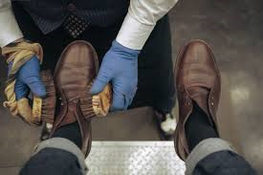
Foot Washing
Feet-washing symbolizes humility and service. The apostles had been quarreling as to who would be greatest in the kingdom which they thought Jesus was about to set up (Luke 22:24-30). Most authorities agree that this quarrel took place before the supper. Peter's question. "Dost thou wash my feet?" shows clearly that his objection lay principally in this, that Jesus, the Lord and Master, should perform such humble service. But Jesus was trying all the time to teach His disciples that true greatness in His kingdom is humility and service. "I am in the midst of you as he that serveth" (Luke 22:27; compare Matthew 5:5; 23:11,12). Humility and service are fundamental virtues in the Christian life.

Slide 10
DO not be puffed up with pride
Don't expect a free ride from no one Don't hold a grudge or a chip and here's why Bitterness keeps you from flying Always stay humble and kind

Slide 11
Genesis 50:15-21
¹⁵ When Joseph’s brothers saw that their father was dead, they said, “What if Joseph holds a grudge against us and pays us back for all the wrongs we did to him?” ¹⁶ So they sent word to Joseph, saying, “Your father left these instructions before he died: ¹⁷ ‘This is what you are to say to Joseph: I ask you to forgive your brothers the sins and the wrongs they committed in treating you so badly.’ Now please forgive the sins of the servants of the God of your father.” When their message came to him, Joseph wept.
¹⁸ His brothers then came and threw themselves down before him. “We are your slaves,” they said.
¹⁹ But Joseph said to them, “Don’t be afraid. Am I in the place of God? ²⁰ You intended to harm me, but God intended it for good to accomplish what is now being done, the saving of many lives. ²¹ So then, don’t be afraid. I will provide for you and your children.” And he reassured them and spoke kindly to them.

Slide 12
Modern Example of Humility

Slide 13
The original Rule of Saint Francis approved by the Pope did not allow ownership of property, requiring members of the order to beg for food while preaching. The austerity was meant to emulate the life and ministry of Jesus Christ. Franciscans traveled and preached in the streets, while staying in church properties.

Slide 14
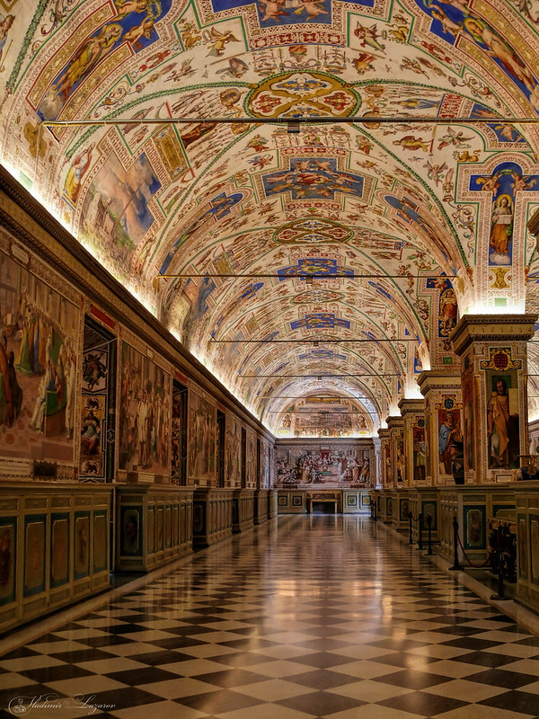
Papal Palace

Slide 15
2 Chronicles 25:18-24
¹⁸ But Jehoash king of Israel replied to Amaziah king of Judah: “A thistle in Lebanon sent a message to a cedar in Lebanon, ‘Give your daughter to my son in marriage.’ Then a wild beast in Lebanon came along and trampled the thistle underfoot. ¹⁹ You say to yourself that you have defeated Edom, and now you are arrogant and proud. But stay at home! Why ask for trouble and cause your own downfall and that of Judah also?”
²⁰ Amaziah, however, would not listen, for God so worked that he might deliver them into the hands of Jehoash, because they sought the gods of Edom. ²¹ So Jehoash king of Israel attacked. He and Amaziah king of Judah faced each other at Beth Shemesh in Judah. ²² Judah was routed by Israel, and every man fled to his home. ²³ Jehoash king of Israel captured Amaziah king of Judah, the son of Joash, the son of Ahaziah,^{[d]} at Beth Shemesh. Then Jehoash brought him to Jerusalem and broke down the wall of Jerusalem from the Ephraim Gate to the Corner Gate—a section about four hundred cubits^{[e]} long. ²⁴ He took all the gold and silver and all the articles found in the temple of God that had been in the care of Obed-Edom, together with the palace treasures and the hostages, and returned to Samaria.

Slide 16
Don’t forgot where (or Who) you came from
When the dreams you're dreamin' come to you When the work you put in is realized Let yourself feel the pride but Always stay humble and kind

Slide 17
Psalm 115:1
Not to us, Lord, not to us but to your name be the glory, because of your love and faithfulness.

Slide 18
Philippians 3:7-11
⁷ But whatever were gains to me I now consider loss for the sake of Christ. ⁸ What is more, I consider everything a loss because of the surpassing worth of knowing Christ Jesus my Lord, for whose sake I have lost all things. I consider them garbage, that I may gain Christ ⁹ and be found in him, not having a righteousness of my own that comes from the law, but that which is through faith in^{[a]} Christ—the righteousness that comes from God on the basis of faith. ¹⁰ I want to know Christ—yes, to know the power of his resurrection and participation in his sufferings, becoming like him in his death, ¹¹ and so, somehow, attaining to the resurrection from the dead.

