Slide 1
Instrumental music in Worship
Scripture Reading Ephesians 5:1-21

Slide 2
One of the first things many people notice about worship within the church of Christ is the absence of instruments. There’s been several debates and arguments on this subject. As we go into this lesson we will look not on what we personally feel or what someone may personally like or want. We are going to simply read the scriptures and find the Bible answer of wether instruments are to be used during Christian worship or wether they aren’t.

Slide 3
First I would like to point out that the church of Christ does indeed use music in worship to our God in heaven.
There is 2 types of music. 1. Vocal 2. Mechanical or Instrumental
Webster defines music as “:the science or art of pleasing, expressive, or intelligible combination of tones, the art of making such combinations, sound having rhythm and melody.”
Before we get into this lesson I’d like each of you here to ask yourself a question. What are we accomplishing by singing during worship?

Slide 4
There are 4 types of worship
1. Vain worship: Matthew 15:9 But in vain they do worship me, teaching for doctrines the commandments of men.
2. Ignorant worship: Acts 17:23For as I passed by, and beheld your devotions, I found an altar with this inscription, TO THE UNKNOWN GOD. Whom therefore ye ignorantly worship, him declare I unto you.

Slide 5
3. Will Worship: Colossians 2:23Which things have indeed a shew of wisdom in will worship, and humility, and neglecting of the body; not in any honour to the satisfying of the flesh.
4. True Worship: John 4:24 God is a Spirit: and they that worship him must worship him in spirit and in truth.

Slide 6
2 Timothy 3: 16-17 All scripture is given by inspiration of God, and is profitable for doctrine, for reproof, for correction, for instruction in righteousness:17 That the man of God may be perfect, throughly furnished unto all good works.
Does it take the use of Instrumental music in worship to make the man of God perfect? Is it a good work? If Instrumental music is indeed to be used in worship then it shouldn’t be hard for us to find it. We have everything we need in the scriptures to tell us how to worship.

Slide 7
Does the use of Instrumental music in worship pertain unto life and godliness? If so, God has already told us about it.
2 Peter 1:3 According as his divine power hath given unto us all things that pertain unto life and godliness, through the knowledge of him that hath called us to glory and virtue:

Slide 8
Now suppose there is no divine authority for Instrumental use in worship. Then what? What if it’s something man has added to worship?
Listen to this. 2 John1:9 Whosoever transgresseth, and abideth not in the doctrine of Christ, hath not God. He that abideth in the doctrine of Christ, he hath both the Father and the Son.
Instrumental music in worship of Christians is not part of the doctrine of Christ. It’s an addition and is going beyond. Which makes it transgression and those doing so hath not God! What a serious thing this is!

Slide 9
Galatians 1: 8-9 But though we, or an angel from heaven, preach any other gospel unto you than that which we have preached unto you, let him be accursed.9 As we said before, so say I now again, If any man preach any other gospel unto you than that ye have received, let him be accursed.
The use of Instrumental music in worship was never preached by Paul or any other inspired preacher. The fact is it was no part of the gospel and came into play hundreds of years after the last inspired preacher was dead. A curse awaits those who don’t preach the gospel of Christ in the correct manner.

Slide 10
Remember the warning we have at the closing of the Bible?
Revelation 22: 18-19 For I testify unto every man that heareth the words of the prophecy of this book, If any man shall add unto these things, God shall add unto him the plagues that are written in this book:19 And if any man shall take away from the words of the book of this prophecy, God shall take away his part out of the book of life, and out of the holy city, and from the things which are written in this book.
Adding instruments to worship is indeed adding to the doctrine and is transgression. We’re talking about loosing your soul here, how serious!

Slide 11
Many will argue the fact that instruments was used in the Old Testament. The answer to this is yes they was. There is different scriptures that show instruments being used under the Old Law. Folks we are no longer under the old law! Do we sacrifice animals?
Jesus died to bring the New Testament into force. Colossians 2: 14-17Blotting out the handwriting of ordinances that was against us, which was contrary to us, and took it out of the way, nailing it to his cross;15 And having spoiled principalities and powers, he made a shew of them openly, triumphing over them in it.16 Let no man therefore judge you in meat, or in drink, or in respect of an holyday, or of the new moon, or of the sabbath days:17 Which are a shadow of things to come; but the body is of Christ.

Slide 12
God speaks to us through his Son and not Moses and the prophets. Hebrews 9:15-17 God, who at sundry times and in divers manners spake in time past unto the fathers by the prophets,2 Hath in these last days spoken unto us by his Son, whom he hath appointed heir of all things, by whom also he made the worlds;
If we are going to worship God we must do it in spirit and in truth, we must find authority in the New Testament for what we practice.

Slide 13
Now before we get into New Testament scriptures relating to music in worship I’d like to direct your minds to one more thought. Some will ask how something can be right in our homes and not right in the church. Let’s make this plain. It is perfectly fine for us to serve pancakes and bacon at our table at home but it would be sinful and wrong for us to add it to the Lords table. Why is it wrong? God has legislated regarding what should be on his table. There is no authority for us to add pancakes and bacon to his table. We are at liberty for what we want to serve at our own table.In the church we have to do as we are commanded. It would be wrong for us to add something other than bread and wine to the Lords table as it would be wrong for us to add Instrumental music to worship.

Slide 14
We sing to praise, glorify and please the God of heaven. Man is NOT the object of worship. Ephesians 5:19 Speaking to yourselves in psalms and hymns and spiritual songs, singing and making melody in your heart to the Lord. Notice that in this text our singing is offered to the Lord.
The Hebrew writer quoted the messianic psalm, Hebrews 2:12 Saying, I will declare thy name unto my brethren, in the midst of the church will I sing praise unto thee.

Slide 15
Singing was practiced in the assembly at Corinth. 1 Corinthians 14:15 What is it then? I will pray with the spirit, and I will pray with the understanding also: I will sing with the spirit, and I will sing with the understanding also.
Our congregational singing engages us to speak to one another as we read in Ephesians 5:19. Congregational singing also serves for us to teach and admonish one another. Colossians 3:16 Let the word of Christ dwell in you richly in all wisdom; teaching and admonishing one another in psalms and hymns and spiritual songs, singing with grace in your hearts to the Lord.

Slide 16
Is there any teaching or admonishing done by the playing of a mechanical instrument? NO. We simply reject Instrumental music because it is not authorized in the scriptures for us to use. Colossians 3:17 And whatsoever ye do in word or deed, do all in the name of the Lord Jesus, giving thanks to God and the Father by him.

Slide 17
Let’s take a look in Acts chapter 16 verse14- 33.
14. And a certain woman named Lydia, a seller of purple, of the city of Thyatira, which worshipped God, heard us: whose heart the Lord opened, that she attended unto the things which were spoken of Paul.15 And when she was baptized, and her household, she besought us, saying, If ye have judged me to be faithful to the Lord, come into my house, and abide there. And she constrained us.16 And it came to pass, as we went to prayer, a certain damsel possessed with a spirit of divination met us, which brought her masters much gain by soothsaying:17 The same followed Paul and us, and cried, saying, These men are the servants of the most high God, which shew unto us the way of salvation.18 And this did she many days. But Paul, being grieved, turned and said to the spirit, I command thee in the name of Jesus Christ to come out of her. And he came out the same hour.

Slide 18
19 And when her masters saw that the hope of their gains was gone, they caught Paul and Silas, and drew them into the marketplace unto the rulers,20 And brought them to the magistrates, saying, These men, being Jews, do exceedingly trouble our city,21 And teach customs, which are not lawful for us to receive, neither to observe, being Romans.22 And the multitude rose up together against them: and the magistrates rent off their clothes, and commanded to beat them.23 And when they had laid many stripes upon them, they cast them into prison, charging the jailor to keep them safely:24 Who, having received such a charge, thrust them into the inner prison, and made their feet fast in the stocks.

Slide 19
25 And at midnight Paul and Silas prayed, and sang praises unto God: and the prisoners heard them.26 And suddenly there was a great earthquake, so that the foundations of the prison were shaken: and immediately all the doors were opened, and every one's bands were loosed.27 And the keeper of the prison awaking out of his sleep, and seeing the prison doors open, he drew out his sword, and would have killed himself, supposing that the prisoners had been fled.28 But Paul cried with a loud voice, saying, Do thyself no harm: for we are all here.29 Then he called for a light, and sprang in, and came trembling, and fell down before Paul and Silas,

Slide 20
30 And brought them out, and said, Sirs, what must I do to be saved?31 And they said, Believe on the Lord Jesus Christ, and thou shalt be saved, and thy house.32 And they spake unto him the word of the Lord, and to all that were in his house.33 And he took them the same hour of the night, and washed their stripes; and was baptized, he and all his, straightway.34 And when he had brought them into his house, he set meat before them, and rejoiced, believing in God with all his house.
Paul and Silas didn’t have Instruments in prison. They simply sang praises!
Hebrews 13:15 By him therefore let us offer the sacrifice of praise to God continually, that is, the fruit of our lips giving thanks to his name.

Slide 21
James 5:13 Is any among you afflicted? let him pray. Is any merry? let him sing psalms.
We are to sing in worship. In no scriptures are we told to play or use instruments in worship. I must point out, under the Old Law there was Instrumental music. Now under the New Law we have NO example for it. Coincidence or the way it’s supposed to be? It’s the way it’s supposed to be! If you worship with Instrumental music you are adding to the word of God. Revelation 22:18-19 For I testify unto every man that heareth the words of the prophecy of this book, If any man shall add unto these things, God shall add unto him the plagues that are written in this book:19 And if any man shall take away from the words of the book of this prophecy, God shall take away his part out of the book of life, and out of the holy city, and from the things which are written in this book.

Slide 22
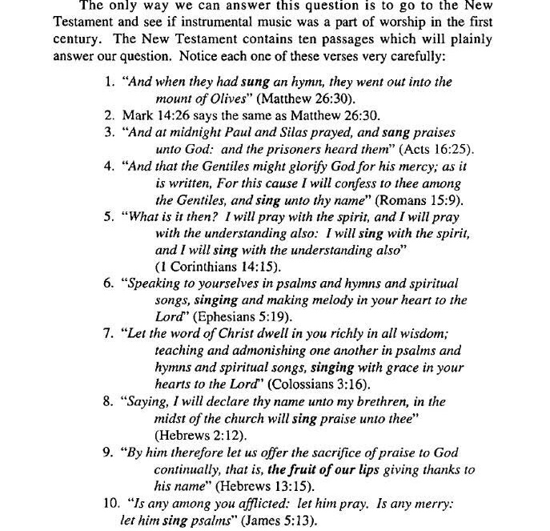

Slide 23
I challenge anyone who questions or thinks Instrumental music is acceptable in worship to find scriptures to prove it being acceptable. It’s not there!
If you’re here today and have not obeyed the gospel of Christ we ask you to seriously think on it. If you’re a member of a religious organization and you wish to obey the truth and join the Lords church you have the opportunity! Jesus said in Mark 16:16 He that believeth and is baptized shall be saved; but he that believeth not shall be damned
2 Corinthians 6:2 (For he saith, I have heard thee in a time accepted, and in the day of salvation have I succoured thee: behold, now is the accepted time; behold, now is the day of salvation.)

