Slide 1
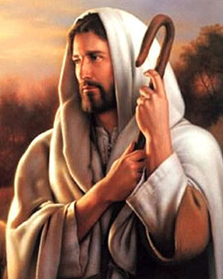
Scripture Reading
Psalms 23:1 The Lord is my shepherd; I shall not want. 2 He maketh me to lie down in green pastures: he leadeth me beside the still waters. 3 He restoreth my soul: he leadeth me in the paths of righteousness for his name's sake. 4 Yea, though I walk through the valley of the shadow of death, I will fear no evil: for thou art with me; thy rod and thy staff they comfort me. 5 Thou preparest a table before me in the presence of mine enemies: thou anointest my head with oil; my cup runneth over. 6 Surely goodness and mercy shall follow me all the days of my life: and I will dwell in the house of the Lord for ever.

Slide 2
Overcoming Discouragement – Wed. Adult Bible Class
Reading Assignment
2 Samuel Chapter 15 through 17
Deuteronomy Chapter 20
Judges Chapter 6 and 7
Discussion:
Causes of Discouragement
Old Testament Examples
Observations
How to Overcome

Slide 3
POWERFUL
PRESENTATIONS!
tips & tricks
Psalm 42:⁵ Why art thou cast down, O my soul? and why art thou disquieted in me? hope thou in God: for I shall yet praise him for the help of his countenance.

Slide 4
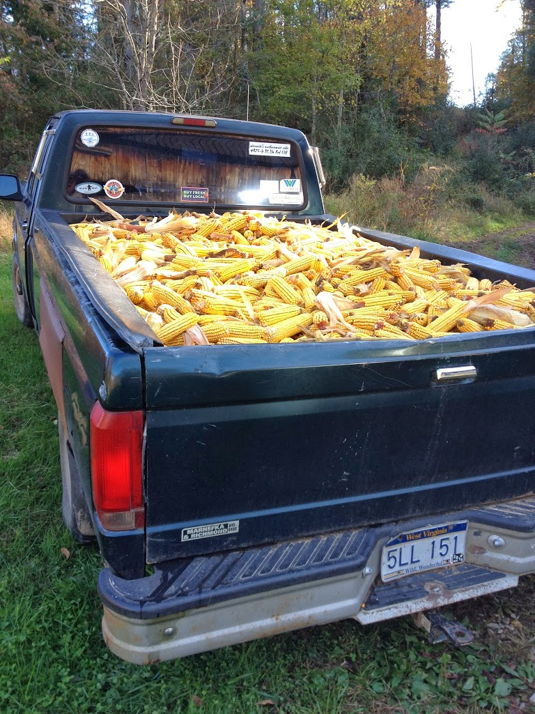
Causes of Discouragement
#1 Cause – Fatigue
When you’re physically or emotionally exhausted, you’re a prime candidate to be infected with discouragement. Your defenses are lowered and things can seem bleaker than they really are. This often occurs when you’re halfway through a major project and you get tired.
I.e. Keep shoveling corn.

Slide 5
Causes of Discouragement
#2 Cause – Frustration
When unfinished tasks pile up, it’s natural to feel overwhelmed. And when trivial matters or the unexpected interrupt you and prevent you from accomplishing what you really need to do, your frustration can easily produce discouragement.

Slide 6
Causes of Discouragement
#3 Cause – Failure
Sometimes your best laid plans fall apart, the project collapses, the deal falls through, no one shows up to the event. How do you react? Do you give in to self-pity? Do you blame others? As one man said, “Just when I think I can make ends meet, somebody moves the ends!” That’s discouraging!

Slide 7
Causes of Discouragement
#4 Cause – Fear
Fear is behind more discouragement than we’d like to admit. The fear of criticism (What will they think?), the fear of responsibility (What if I can’t handle this?), and the fear of failure (What if I blow it?) can cause a major onset of the blues.

Slide 8
HOW TO OVERCOME DISCOURAGEMENT
The first observation –
discouragement is a universal problem
1 Corinthians 10:12 Therefore let him who thinks he stands take heed lest he fall.
2 Sam. 17: 10 "And even he who is valiant, whose heart is like the heart of a lion, will melt completely.
The second observation - discouragement is serious and it demands our immediate attention.
Notes:
11 And David said to Abishai, and to all his servants, Behold, my son, which came forth of my bowels, seeketh my life: how much more now may this Benjamite do it? let him alone, and let him curse; for the Lord hath bidden him.
17 Moreover Ahithophel said unto Absalom, Let me now choose out twelve thousand men, and I will arise and pursue after David this night:

Slide 9
HOW TO OVERCOME DISCOURAGEMENT
Deuteronomy 20:8 "The officers shall speak further to the people, and say, 'What man is there who is fearful and fainthearted? Let him go and return to his house, lest the heart of his brethren faint like his heart.'
Judges 7:3 "Now therefore, proclaim in the hearing of the people, saying, 'Whoever is fearful and afraid, let him turn and depart at once from Mount Gilead.' " And twenty-two thousand of the people returned, and ten thousand remained.
Notes:
7 Then Jerubbaal, who is Gideon, and all the people that were with him, rose up early, and pitched beside the well of Harod: so that the host of the Midianites were on the north side of them, by the hill of Moreh, in the valley.
2 And the Lord said unto Gideon, The people that are with thee are too many for me to give the Midianites into their hands, lest Israel vaunt themselves against me, saying, Mine own hand hath saved me.

Slide 10
HOW TO OVERCOME DISCOURAGEMENT
The third observation - discouragement is a very effective tool of our adversary the devil
Eph 4:26 "Be angry, and do not sin": do not let the sun go down on your wrath, 27 nor give place to the devil.
Jesus says, “away with you Satan” (Mat. 4:10) and “get behind me Satan” (Mat. 16:23)
Notes:
Devil wants you to become discouraged and stop trying!

Slide 11
HOW TO OVERCOME DISCOURAGEMENT
The fourth observation - God has taught us through his word on how to overcome discouragement.
2 Peter 1:3 His divine power has given to us all things that pertain to life and godliness, through the knowledge of Him who called us by glory and virtue..
2 Timothy 3:16 All Scripture is given by inspiration of God, and is profitable for doctrine, for reproof, for correction, for instruction in righteousness, 17 that the man of God may be complete, thoroughly equipped for every good work.
Notes:
Through the word we can conquer and overcome discouragement!

Slide 12
HOW TO OVERCOME DISCOURAGEMENT
John 14:1 "Let not your heart be troubled; you believe in God, believe also in Me.
1 Samuel 17:32 "Let no man's heart fail because of him; your servant will go and fight with this Philistine.“
Some encouraging verses
Romans 8:28 And we know that all things work together for good to those who love God, to those who are the called according to His purpose.
Genesis 50:20 "But as for you, you meant evil against me; but God meant it for good, in order to bring it about as it is this day, to save many people alive.
Notes:
When we have a heart and mind directed to serving God and pleasing Him, we know everything is going to be alright. God is in control!

Slide 13
HOW TO OVERCOME DISCOURAGEMENT
Philippians 4:13 I can do all things through Christ who strengthens me.
Psalm 23:1 The LORD is my shepherd; I shall not want.
4 Yea, though I walk through the valley of the shadow of death, I will fear no evil; For You are with me; Your rod and Your staff, they comfort me.

Slide 14
HOW TO OVERCOME DISCOURAGEMENT
Heb 13: 5 Let your conduct be without covetousness; be content with such things as you have. For He Himself has said, "I will never leave you nor forsake you." 6 So we may boldly say: "The LORD is my helper; I will not fear. What can man do to me?“
Psalm 46:1 God is our refuge and strength, A very present help in trouble.
Psalm 46:10 Be still, and know that I am God
Notes:
In life there will be tough times, but God will never leave us or forsake us. Till the Storm Passes by.

Slide 15
HOW TO OVERCOME DISCOURAGEMENT
DETERMINE that we will not remain discouraged
Proverbs 23:7 For as he thinks in his heart, so is he
2 Cor 10:5 tells about bringing every thought into captivity to the obedience of Christ,
Daniel 1:8 But Daniel purposed in his heart that he would not defile himself.
Ezra 7:10 For Ezra had prepared his heart to seek the Law of the LORD, and to do it, and to teach statutes and ordinances in Israel
Notes:
We need to have determination and resolve!

Slide 16
HOW TO OVERCOME DISCOURAGEMENT
INSIST on finding the good in every situation
Psalm 119:71 It is good for me that I have been afflicted, That I may learn Your statutes.
SET realistic Goals that you can achieve
Mark 1:17 Then Jesus said to them, "Follow Me, and I will make you become fishers of men.“

Slide 17
HOW TO OVERCOME DISCOURAGEMENT
Mark 14:3 And being in Bethany at the house of Simon the leper, as He sat at the table, a woman came having an alabaster flask of very costly oil of spikenard. Then she broke the flask and poured it on His head. 4 But there were some who were indignant among themselves, and said, "Why was this fragrant oil wasted? 5 "For it might have been sold for more than three hundred denarii and given to the poor." And they criticized her sharply. 6 But Jesus said, "Let her alone. Why do you trouble her? She has done a good work for Me. 7 "For you have the poor with you always, and whenever you wish you may do them good; but Me you do not have always. 8 "She has done what she could. She has come beforehand to anoint My body for burial. 9 "Assuredly, I say to you, wherever this gospel is preached in the whole world, what this woman has done will also be told as a memorial to her."

Slide 18
HOW TO OVERCOME DISCOURAGEMENT
CULTIVATE a positive outlook on life
Outlook determines outcome
Numbers 13:31 But the men who had gone up with him said, "We are not able to go up against the people, for they are stronger than we." 32 And they gave the children of Israel a bad report of the land which they had spied out, saying, "The land through which we have gone as spies is a land that devours its inhabitants, and all the people whom we saw in it are men of great stature. 33 "There we saw the giants (the descendants of Anak came from the giants); and we were like grasshoppers in our own sight, and so we were in their sight."

Slide 19
HOW TO OVERCOME DISCOURAGEMENT
OBSERVE Gods dealings with his children
Psalm 37:25 I have been young, and now am old; Yet I have not seen the righteous forsaken, Nor his descendants begging bread.
John 10:29 "My Father, who has given them to Me, is greater than all; and no one is able to snatch them out of My Father's hand
USE difficult times to strengthen your faith
Job 14:1 "Man who is born of woman Is of few days and full of trouble.

Slide 20
HOW TO OVERCOME DISCOURAGEMENT
OBSERVE Gods dealings with his children
2 Timothy 2:3 You therefore must endure hardship as a good soldier of Jesus Christ.
James 5:10 My brethren, take the prophets, who spoke in the name of the Lord, as an example of suffering and patience. 11 Indeed we count them blessed who endure. You have heard of the perseverance of Job and seen the end intended by the Lord -- that the Lord is very compassionate and merciful.

Slide 21
HOW TO OVERCOME DISCOURAGEMENT
RESIST your adversary the devil
James 4:7 Resist the devil and he will flee from you
1 Peter 5:9 Resist him, steadfast in the faith, knowing that the same sufferings are experienced by your brotherhood in the world.

Slide 22
HOW TO OVERCOME DISCOURAGEMENT
AVOID self-pity at all cost
Hebrews 12:3 For consider Him who endured such hostility from sinners against Himself, lest you become weary and discouraged in your souls.
Hebrews 12:1 Therefore we also, since we are surrounded by so great a cloud of witnesses, let us lay aside every weight, and the sin which so easily ensnares us, and let us run with endurance the race that is set before us, 2 looking unto Jesus, the author and finisher of our faith, who for the joy that was set before Him endured the cross, despising the shame, and has sat down at the right hand of the throne of God.

Slide 23
HOW TO OVERCOME DISCOURAGEMENT
GET involved in the Lord’s work
ENCOURAGE others
Barnabas literally means son of encouragement. (Acts 4:36)
1 Thessalonians 3:1 Therefore, when we could no longer endure it, we thought it good to be left in Athens alone, 2 and sent Timothy, our brother and minister of God, and our fellow laborer in the gospel of Christ, to establish you and encourage you concerning your faith, 3 that no one should be shaken by these afflictions; for you yourselves know that we are appointed to this.

Slide 24
HOW TO OVERCOME DISCOURAGEMENT
MAKE prayer a daily habit
Matthew 26:41 "Watch and pray, lest you enter into temptation.
Don’t dwell on the past
Phil 3:13 Brethren, I do not count myself to have apprehended; but one thing I do, forgetting those things which are behind and reaching forward to those things which are ahead, 14 I press toward the goal for the prize of the upward call of God in Christ Jesus.

Slide 25
POWERFUL
PRESENTATIONS!
NURTURE a patient spirit with yourself
1Thess 5:14 tells us to be patient with all men
Ezra 10:13 ..this is not a work that will be done in 1 or 2 days
TAKE life one day at a time
Matthew 6:34 "Therefore do not worry about tomorrow, for tomorrow will worry about its own things. Sufficient for the day is its own trouble.
tips & tricks

