Slide 1
Prophecy of tyre
Ezekiel 26:1-21 and 29:17-21

Slide 2
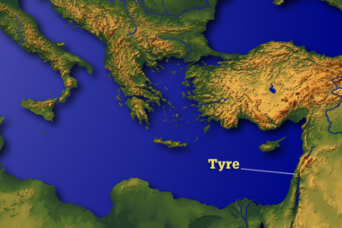
Facts about the ancient city of Tyre
It is estimated that the city reigned around 2300 years
The city was geographically located for advantageous port access
This cause the city to be described as the wealthiest and most important city of the Phoenician empire

Slide 3
Regarded as impregnable
Wallace Fleming (1966) The History of Tyre “As early as 1400 B.C. Tyre was not only a great city but was considered impregnable”
It’s coastal locations provided many defensive aspects that made it difficult to attack
Because of Tyre’s lofty status, the city was full of greed and violence
Ezekiel 26:2-3
Tyre sought to lay waste to Jerusalem for financial gain

Slide 4
Ezekiel's prophecy: Many nations would come against Tyre
A few months after the prophecy, Nebuchadnezzar siege Tyre for 13 years, ending around 538 BC
In 392 BC Tyre was attached during the war between the Persians and Evagorus of Cyprus
In 332 BC Alexander the Great captured Tyre
In 315 BD Tyre was besieged by Ptolemy of Egypt

Slide 5
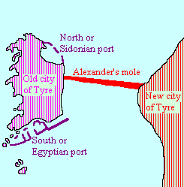
Ezekiel's prophecy: Ezekiel 26:12 King James Version (KJV) ¹² And they shall make a spoil of thy riches, and make a prey of thy merchandise: and they shall break down thy walls, and destroy thy pleasant houses: and they shall lay thy stones and thy timber and thy dust in the midst of the water.
In his dealings with Tyre, Alexander asserted that he wished to make a personal sacrifice in the temple of Heracles on the island city of Tyre. Apparently, because the Tyrians considered their island refuge virtually impregnable, with war machines covering the walls, and rapidly moving water acting as an effective barrier from land attack, they refused his request. Upon receiving their refusal, Alexander immediately set to work on a plan to besiege and conquer the city. He set upon the task of building a land bridge or cause way (Siculus calls it a “mole”) from the mainland city of Tyre to the island city. Siculus stated: “Immediately he demolished what was called Old Tyre and set many tens of thousands of men to work carrying stones to construct a mole” (17.40). Curtius Rufus noted: “Large quantities of rock were available, furnished by old Tyre” (4.2.18). This unprecedented action took the Tyrians by complete surprise. Fleming noted: “In former times the city had shown herself well nigh impregnable. That Alexander’s method of attack was not anticipated is not strange, for there was no precedent for it in the annals of warfare” (p. 56). And yet, even though this action was unprecedented militarily, it was exactly what one might expect from the description of the destruction of Tyre given by Ezekiel hundreds of years prior to Alexander’s actions. The mainland city was demolished and all her stones, timber, and soil were thrown into the midst of the sea.

Slide 6
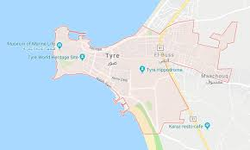
Ezekiel's prophecy: The city of Tyre shall never be rebuilt

Slide 7
Ezekiel 26:19 King James Version (KJV) ¹⁹ For thus saith the Lord God; When I shall make thee a desolate city, like the cities that are not inhabited; when I shall bring up the deep upon thee, and great waters shall cover thee;

Slide 8
Ezekiel's prophecy was addressed to ancient Tyre
Benjamin of Tudela (1170 AD): From Sidon it is half a day’s journey to Sarepta (Sarfend), which belongs to Sidon. Thence it is a half-day to New Tyre (Sur), which is a very fine city, with a harbour in its midst.... There is no harbour like this in the whole world. Tyre is a beautiful city.... In the vicinity is found sugar of a high class, for men plant it here, and people come from all lands to buy it. A man can ascend the walls of New Tyre and see ancient Tyre, which the sea has now covered, lying at a stone’s throw from the new city. And should one care to go forth by boat, one can see the castles, market-places, streets, and palaces in the bed of the sea.

