Slide 1
Scripture Reading
Acts 27: 25 Wherefore, sirs, be of good cheer: for I believe God, that it shall be even as it was told me. 26 Howbeit we must be cast upon a certain island. 27 But when the fourteenth night was come, as we were driven up and down in Adria, about midnight the shipmen deemed that they drew near to some country; 28 And sounded, and found it twenty fathoms: and when they had gone a little further, they sounded again, and found it fifteen fathoms. 29 Then fearing lest we should have fallen upon rocks, they cast four anchors out of the stern, and wished for the day.

Slide 2
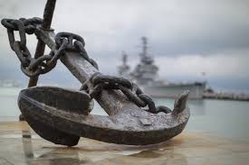
Introduction
You will come upon a real storm in life
How you handle the storm will determine how you will live
Some will be trapped or destroyed in the storm
Paul was being taken captive to Rome where he would die
Four anchors will keep our lives on the right course and carry us safely onto the shore
2
Notes:
There will be a time in the life of most Christians that you will come upon a real storm.
How you handle that storm will determine a great deal as to how you live the remainder of your Christian life. We are living in a day when Christianity is not growing like it should. Largely the reason is that too many of God's people are stalled out somewhere in the midst of a storm.
Have you allowed the storms of life to move in and take over your course to the happiness of the Christian life; therefore defeat has overtaken you, and you have no real plan or pattern to go on in living for Christ.
Paul was being taken captive to Rome where he would eventually die. But he went thru many storms along the way as he journeyed toward the end of his life.
In this very popular portion of Scripture there are four anchors that will keep your Christian life right on course until you land safely on the other shore.

Slide 3
The Four Anchors that will hold!
God
Faith
The Church
The Gospel – The Story of Jesus

Slide 4
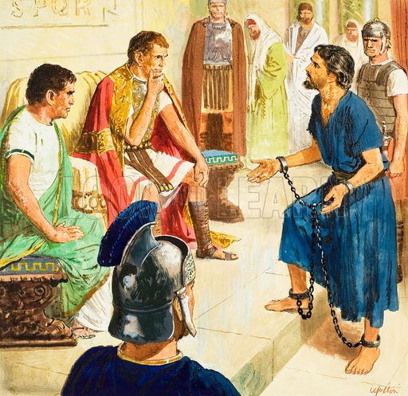
Paul Appeals to Caesar before Festus
Acts 25:9 But Festus, wanting to do the Jews a favor, answered Paul and said, “Are you willing to go up to Jerusalem and there be judged before me concerning these things?”
¹⁰ So Paul said, “I stand at Caesar’s judgment seat, where I ought to be judged. To the Jews I have done no wrong, as you very well know. ¹¹ For if I am an offender, or have committed anything deserving of death, I do not object to dying; but if there is nothing in these things of which these men accuse me, no one can deliver me to them. I appeal to Caesar.”
¹² Then Festus, when he had conferred with the council, answered, “You have appealed to Caesar? To Caesar you shall go!”

Slide 5
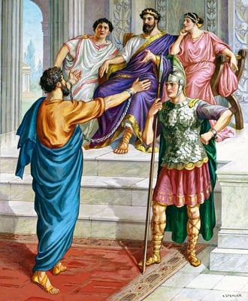
Paul before Agrippa
Acts 25:23 So the next day, when Agrippa and Bernice had come with great pomp, and had entered the auditorium with the commanders and the prominent men of the city, at Festus’ command Paul was brought in. 24 And Festus said: “King Agrippa and all the men who are here present with us, you see this man about whom the whole assembly of the Jews petitioned me, both at Jerusalem and here, crying out that he was not fit to live any longer. 25 But when I found that he had committed nothing deserving of death, and that he himself had appealed to Augustus, I decided to send him. 26 I have nothing certain to write to my lord concerning him. Therefore I have brought him out before you, and especially before you, King Agrippa, so that after the examination has taken place I may have something to write. 27 For it seems to me unreasonable to send a prisoner and not to specify the charges against him.”

Slide 6
Paul before Agrippa
Paul Recounts his early life
Paul recounts his conversion
Paul recounts his post-conversion
Acts 26:²⁸ Then Agrippa said to Paul, “You almost persuade me to become a Christian.”
²⁹ And Paul said, “I would to God that not only you, but also all who hear me today, might become both almost and altogether such as I am, except for these chains.”
³⁰ When he had said these things, the king stood up, as well as the governor and Bernice and those who sat with them; ³¹ and when they had gone aside, they talked among themselves, saying, “This man is doing nothing deserving of death or chains.”
³² Then Agrippa said to Festus, “This man might have been set free if he had not appealed to Caesar.”

Slide 7
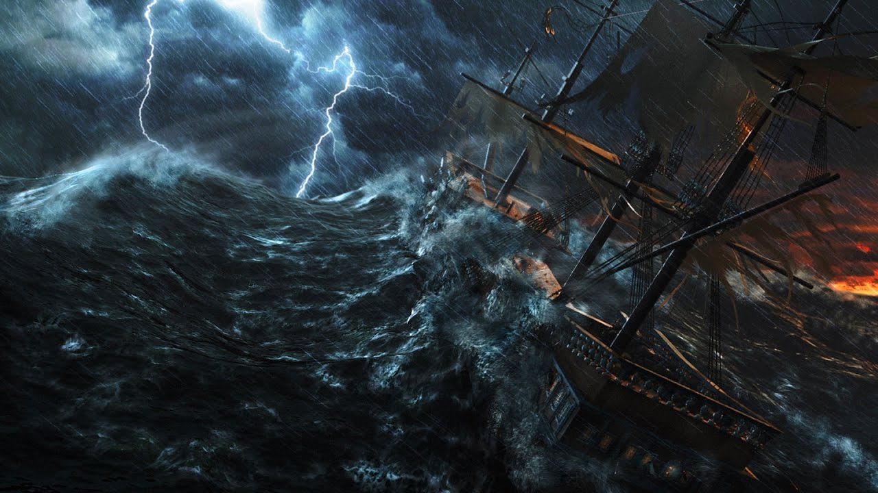
The Warning!
Acts 27
Paul warned them of impending death if they continued on
The centurion listened to helmsmen
The Fair Havens, near the city of Lasea harbor was not suitable to winter in
The majority advised to set sail from there also, if by any means they could reach Phoenix, a harbor of Crete
Notes:
Why do we not listen to right people? We all can probably think of a time when we followed the wrong advice. Sometimes bad advice comes from ourselves.
Majority seems to pick the wrong. Proverbs 14:12, which says, "There is a way which seemeth right unto a man, but the end thereof are the ways of death.“

Slide 8
The Storm!
The calm before the storm
Caught in storm
Disaster and loss
Acts 27:13 When the south wind blew softly, supposing that they had obtained their desire, putting out to sea, they sailed close by Crete. 14 But not long after, a tempestuous head wind arose, called Euroclydon. 15 So when the ship was caught, and could not head into the wind, we let her drive. ..19 On the third day we threw the ship’s tackle overboard with our own hands. 20 Now when neither sun nor stars appeared for many days, and no small tempest beat on us, all hope that we would be saved was finally given up.
Notes:
The calm before the storm. Everything is going to be smooth sailing. Everything is flowing my way, The game of Risk.
Then all of a sudden our lives can change. Are we ready when it comes?

Slide 9
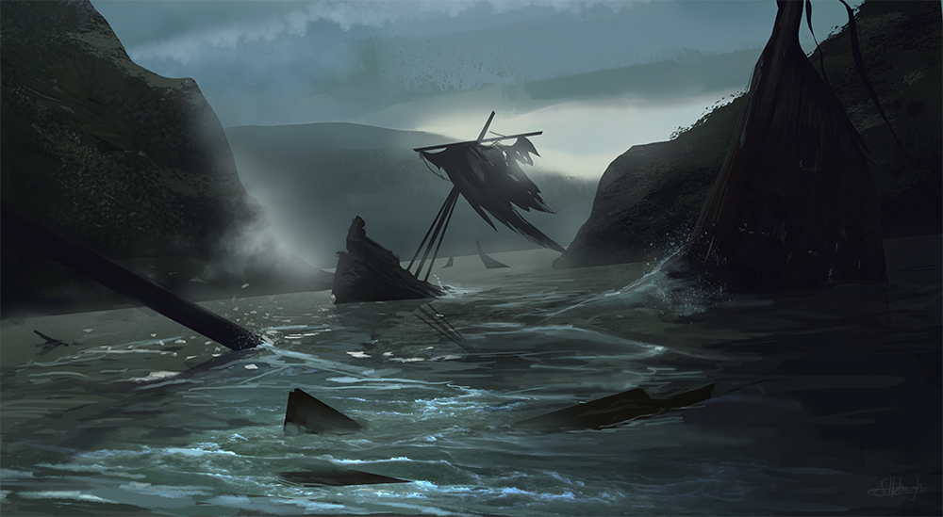
The Hope and Salvation!
The calm before the storm
Caught in storm
Disaster and loss
Acts 27:21 But after long abstinence from food, then Paul stood in the midst of them and said, “Men, you should have listened to me, and not have sailed from Crete and incurred this disaster and loss. Acts 27: 25 Wherefore, sirs, be of good cheer: for I believe God, that it shall be even as it was told me. 26 Howbeit we must be cast upon a certain island. 27 But when the fourteenth night was come, as we were driven up and down in Adria, about midnight the shipmen deemed that they drew near to some country; 28 And sounded, and found it twenty fathoms: and when they had gone a little further, they sounded again, and found it fifteen fathoms. 29 Then fearing lest we should have fallen upon rocks, they cast four anchors out of the stern, and wished for the day.
Notes:
I told you so! Randy Travis. Paul didn’t rub it in, but had words of encouragement.
They cast 4 anchors to keep the boat from drifting into the rocks and causing everyone to be destroyed. I want to look at 4 anchors we have today that can keep us anchored and strong.

Slide 10
Quote and Image Slide
I. ANCHOR ONE - Vs. 24 - GOD
Acts 27:24 "Saying, Fear not, Paul; thou must be brought before Caesar: and, lo, God hath given thee all them that sail with thee."
The Almighty God was with Paul and he knew it
He knew that no one could go against the will of God! (John 10:29; Rom 8:38)
“
10
Notes:
John10:29 My Father, which gave them me, is greater than all; and no man is able to pluck them out of my Father's hand. If God is with us who can challenge us. Who or what shall we fear.
Romans 8:38 For I am persuaded, that neither death, nor life, nor angels, nor principalities, nor powers, nor things present, nor things to come, 39 Nor height, nor depth, nor any other creature, shall be able to separate us from the love of God, which is in Christ Jesus our Lord.
Paul knew God was with them.

Slide 11
Quote and Image Slide
I. ANCHOR ONE - Vs. 24 - GOD.
A. Proclamation Of God. Vs. 24, "Fear not." Fear does not come from God. The context is speaking about Paul not having fear in doing God’s purpose.
B. Plan Of God. Vs. 24, "must be brought before Caesar." God has a plan for you.
2 Cor 11:23-27 tell about all his beatings, stonings, imprisonments, hunger, cold, nakedness, fear, etc.
Gal 6:17 "From henceforth let no man trouble me: for I bear in my body the marks of the Lord Jesus."
“
11
Notes:
A. Outside of that plan, or being involved in anything except that plan, will bring unhappiness. It will bring defeat and discouragement.
God’s plan may not always be enjoyable. When we examine Paul’s life, we can see persecutions, severe hardships.
2 Cor 11:23-27 tell about all his beatings, stonings, imprisonments, hunger, cold, nakedness, fear, etc.
Let me remind you that none of this was done in chastisement, but rather because Paul was fulfilling the plan of God.
He speaks of his bearing the marks in his body. I would venture to say that Paul was not rejoicing with laughter while he was telling these incidents. He is telling us that there will be hard times while doing the plan of God.
It’s not always smooth sailing, and God didn’t promise us a storm free journey, but He did promise we would make it to the other side. God is an anchor that will hold!

Slide 12
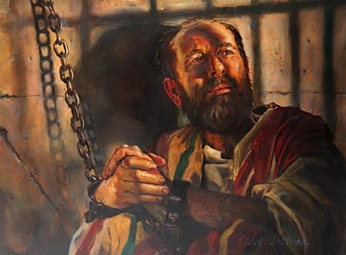
Quote and Image Slide
II. ANCHOR TWO - Vs. 25 - FAITH. "I believe God."
The Word of God will be of little benefit to you unless you exercise faith in it. The whole key to your success day by day is whether you believe God or not. (1 Cor. 2:9; 1 Pet. 1:4; Rev. 2:10)
Paul’s whole Christian life had been that which must believe God.
“
Acts 16: 24 Who, having received such a charge, thrust them into the inner prison, and made their feet fast in the stocks. 25 And at midnight Paul and Silas prayed, and sang praises unto God: and the prisoners heard them.
12
Notes:
Acts 27: 25 Wherefore, sirs, be of good cheer: for I believe God, that it shall be even as it was told me.
1 Corinthians 2:9 But, as it is written, “What no eye has seen, nor ear heard, nor the heart of man imagined, what God has prepared for those who love him”—
1 Peter 1:4 To an inheritance that is imperishable, undefiled, and unfading, kept in heaven for you,
Revelation 2:10 Do not fear what you are about to suffer. Behold, the devil is about to throw some of you into prison, that you may be tested, and for ten days you will have tribulation. Be faithful unto death, and I will give you the crown of life.
I think of the time he and Silas were thrown into the Philippian jail. They had been beaten and threatened, but he still hung onto that anchor of faith.

Slide 13
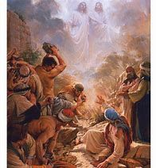
Quote and Image Slide
II. ANCHOR TWO - Vs. 25 - FAITH. "I believe God."
When he was stoned at Lystra and left for dead, he was hanging on to that anchor of faith.
“
Acts 14:19 But Jews came from Antioch and Iconium, and having persuaded the crowds, they stoned Paul and dragged him out of the city, supposing that he was dead.
13
Notes:
Remember, God has instructed each of us to live our lives, and to raise our children according to His Word. That will require faith.
We are instructed by His Word to give our all to Him. That will require faith.
Paul said, “I believe God...” He knew that the same God that had delivered him from the Philippian jail and the firing squad in Lystra would deliver him in this situation.
This same God will see you through also. Keep hold of that anchor of faith.

Slide 14
Quote and Image Slide
III. ANCHOR THREE - Vs. 31 - SHIP. “Except ye abide in the ship...”
A. The Purpose of the Ship.
Mat 16:18 "And I say also unto thee, That thou art Peter, and upon this rock I will build my church; and the gates of hell shall not prevail against it.“ 19 "And I will give unto thee the keys of the kingdom of heaven: and whatsoever thou shalt bind on earth shall be bound in heaven: and whatsoever thou shalt loose on earth shall be loosed in heaven."
“
14
Notes:
This is a type of the Local Church…the local fellowship. “2 or more fellows in the same ship.” That’s us at The West Main Street Church of Christ! Don’t you love our fellowship? So why do so many jump overboard?
Jesus organized His church during the days of His ministry on the earth. (Matt 16:18-19) The Church is the vessel by which we preach the gospel. The N.T. Church is the vehicle by which we take the message to the world. That’s the purpose of the ship.
Salvation is not in trusting in the church, but in Christ. The church is the messenger. The reason there are so many fragmented groups and so much confusion in the Gospel of salvation is that individuals have broken off from the N.T. Church and have begun a private presentation of the message of salvation. That is not God’s intent. The command to evangelize the world was given to the N.T. Church.

Slide 15
Quote and Image Slide
III. ANCHOR THREE - Vs. 31 - SHIP. “Except ye abide in the ship...”
B. The Importance of the Ship. Encouragement, Admonishment, Comfort, We help each other
Heb 10:23-25 Let us hold fast the confession of our hope without wavering, for he who promised is faithful. And let us consider how to stir up one another to love and good works, not neglecting to meet together, as is the habit of some, but encouraging one another, and all the more as you see the Day drawing near.
Galatians 6:2 Bear one another's burdens, and so fulfill the law of Christ
Colossians 3:16 Let the word of Christ dwell in you richly, teaching and admonishing one another in all wisdom, singing psalms and hymns and spiritual songs, with thankfulness in your hearts to God.
Romans 8:28 And we know that for those who love God all things work together for good, for those who are called according to his purpose.
“
15
Notes:
The church is where we can be around friends, brothers, sisters of Christ, joint heirs. Those who love and care for you. Those that work hard together to spread the gospel, strengthen each others faith. Are you building up or tearing down?

Slide 16
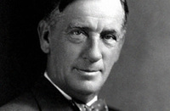
Quote and Image Slide
“I watched them tearing a building down,
A gang of men in a busy town.
With a ho-heave-ho and a lusty yell,
They swung a beam, and the side wall fell.
I asked the foreman: "Are these skilled--
And the men you'd hire if you had to build?"
He gave me a laugh and said: "No, indeed!
Just common labor is all I need.
I can wreck in a day or two
What builders have taken a year to do."
And I thought to myself as I went my way,
Which of these roles have I tried to play?
Am I a builder who works with care
Measuring life by a rule and square?
Am I shaping my deeds to a well made Plan,
Patiently doing the best I can?
Or am I a wrecker, who walks the town
Content with the labor of tearing down?”
III. ANCHOR THREE - Vs. 31 - SHIP. “Except ye abide in the ship...”
B. The Importance of the Ship. Encouragement, Admonishment, Comfort, We help each other
“
16
Notes:
We see this in the church today. Some can destroy in one day what took years to build. Cherry wall unit. 30 minutes to tear apart and took me weeks to build. Be a builder and do your best to build up and encourage.
The Local Church is a Strong Anchor, “Stay in the Ship!”

Slide 17
Quote and Image Slide
IV. ANCHOR FOUR - Vs. 33 - MEAT “Take meat...” The Gospel – the story of Jesus!
A. It Will Bring Good Health. Vs. 34a.
Acts 27:34 "Wherefore I pray you to take some meat: for this is for your health..."
B. It Will Bring Safety. Vs. 34b.
Acts 27:34 "…for there shall not an hair fall from the head of any of you." You need it everyday. (Psalm 46:1; Deut 31:6; John 14:1-3)
“
17
Notes:
Paul told them that they would not be able to withstand the journey unless they ate meat for strength. They had fasted for 14 days.
A steady diet of the Word of God will make you healthy spiritually. We need meat to live as well. The meet of the gospel will feed our spiritual bodies. We need that to be fed more than our physical bodies. The good news of the gospel will give us the strength to endure the storm.
Psalm 46:1 God is our refuge and strength, a very present help in trouble.
Deuteronomy 31:6 “Be strong and courageous. Do not be afraid or terrified because of them, for the LORD your God goes with you; he will never leave you nor forsake you.”
John 14: 1Let not your heart be troubled: ye believe in God, believe also in me. 2 In my Father's house are many mansions: if it were not so, I would have told you. I go to prepare a place for you. 3 And if I go and prepare a place for you, I will come again, and receive you unto myself; that where I am, there ye may be also.

Slide 18
Quote and Image Slide
IV. ANCHOR FOUR - Vs. 33 - MEAT “Take meat...” The Gospel – the story of Jesus!
C. It Will Bring Good Cheer. Vs. 36.
Acts 27:36 "Then were they all of good cheer, and they also took some meat."
D. It Will Bring You to Shore. Vs. 44.
Acts 27:44 "And the rest, some on boards, and some on broken pieces of the ship. And so it came to pass, that they escaped all safe to land."
“
18
Notes:
C. Those that read the Bible remind themselves of the great story of Jesus and bring joy to their heart. They will weather the storm. They will be happy.
D. When you see a family, an individual, a preacher, or any child of God sinking in the sea of turmoil of life it will be because he/she did not follow the advice given in this passage of scripture.
When you partake of the meat of God, His Word, and follow its guidance you will come out successful no matter what kind of waters you are going through. It is impossible to fail or be defeated when allowing the Word of God to be your guide. It was an anchor to Paul and can be an anchor to your soul.

Slide 19
The Four Anchors that will hold!
God
Faith
The Church
The Gospel – The Story of Jesus

Slide 20
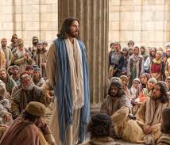
Quote and Image Slide
Jesus Said:
14 Let not your heart be troubled: ye believe in God, believe also in me. 2 In my Father's house are many mansions: if it were not so, I would have told you. I go to prepare a place for you. 3 And if I go and prepare a place for you, I will come again, and receive you unto myself; that where I am, there ye may be also. 4 And whither I go ye know, and the way ye know. 5 Thomas saith unto him, Lord, we know not whither thou goest; and how can we know the way? 6 Jesus saith unto him, I am the way, the truth, and the life: no man cometh unto the Father, but by me.
“
20
Notes:
Won’t you come to Jesus today!

