Slide 1
Scripture Reading
2 Samuel 6:1-7 ¹Again, David gathered together all the chosen men of Israel, thirty thousand. ²And David arose, and went with all the people that were with him from Baale of Judah, to bring up from thence the ark of God, whose name is called by the name of the LORD of hosts that dwelleth between the cherubims. ³And they set the ark of God upon a new cart, and brought it out of the house of Abinadab that was in Gibeah: and Uzzah and Ahio, the sons of Abinadab, drave the new cart. ⁴And they brought it out of the house of Abinadab which was at Gibeah, accompanying the ark of God: and Ahio went before the ark. ⁵And David and all the house of Israel played before the LORD on all manner of instruments made of fir wood, even on harps, and on psalteries, and on timbrels, and on cornets, and on cymbals. ⁶And when they came to Nachon's threshingfloor, Uzzah put forth his hand to the ark of God, and took hold of it; for the oxen shook it. ⁷And the anger of the LORD was kindled against Uzzah; and God smote him there for his error; and there he died by the ark of God.

Slide 3
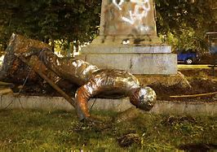
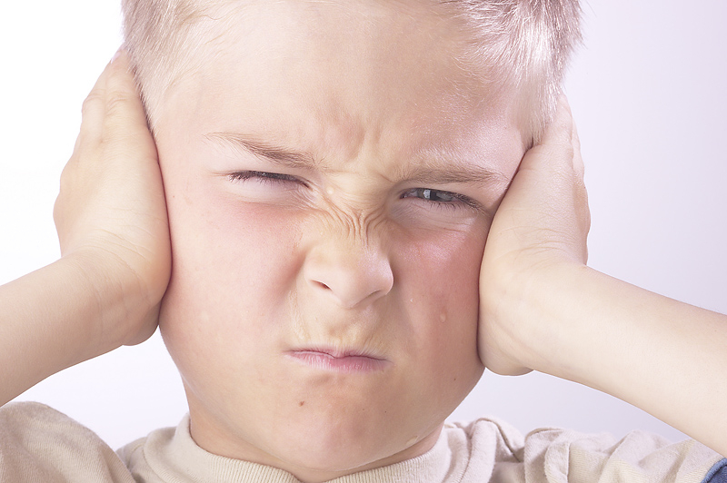
RESPECT
Rebellious- showing a desire to resist authority, control, or convention.
1 Samuel 8:7 And the Lord said unto Samuel, Hearken unto the voice of the people in all that they say unto thee: for they have not rejected thee, but they have rejected me, that I should not reign over them.
Psalms 107:11 Because they had rebelled against the words of God And spurned the counsel of the Most High.
Ephesians 6:1-3 - Children, obey your parents in the Lord: for this is right.² Honour thy father and mother; which is the first commandment with promise;³ That it may be well with thee, and thou mayest live long on the earth.
Romans 13:1-2 Let every soul be subject unto the higher powers. For there is no power but of God: the powers that be are ordained of God.² Whosoever therefore resisteth the power, resisteth the ordinance of God: and they that resist shall receive to themselves damnation.

Slide 4
RESPECT
educated- the process of receiving or giving systematic instruction, 2) an enlightening experience.
Proverbs 16:16 – How much better [is it] to get wisdom than gold! and to get understanding rather to be chosen than silver!
Deuteronomy 11:19 - And ye shall teach them your children, speaking of them when thou sittest in thine house, and when thou walkest by the way, when thou liest down, and when thou risest up.
1 John 4:1 - Beloved, do not believe every spirit, but test the spirits, whether they are of God; because many false prophets have gone out into the world.
Proverbs 22:6 - Train up a child in the way he should go: and when he is old, he will not depart from it
Colossians 4:6- Let your speech always be with grace, seasoned with salt, that you may know how you ought to answer each one.

Slide 5
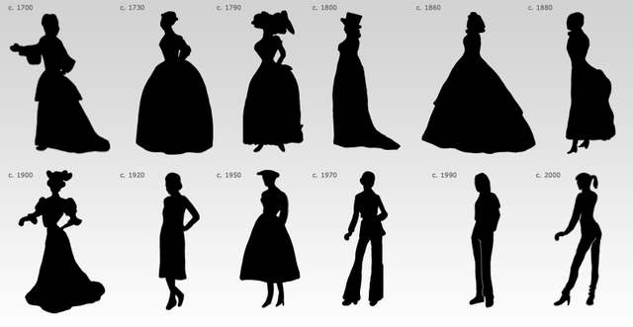
RESPECT
Sin- an immoral act considered to be a transgression against divine law.
James 4:17 - Therefore to him that knoweth to do good, and doeth [it] not, to him it is sin.
Romans 6:23 - For the wages of sin [is] death; but the gift of God [is] eternal life through Jesus Christ our Lord.
1 John 3:4 - Whosoever committeth sin transgresseth also the law: for sin is the transgression of the law.
James 1:15 - Then when lust hath conceived, it bringeth forth sin: and sin, when it is finished, bringeth forth death

Slide 6
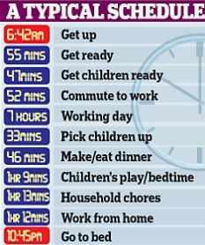
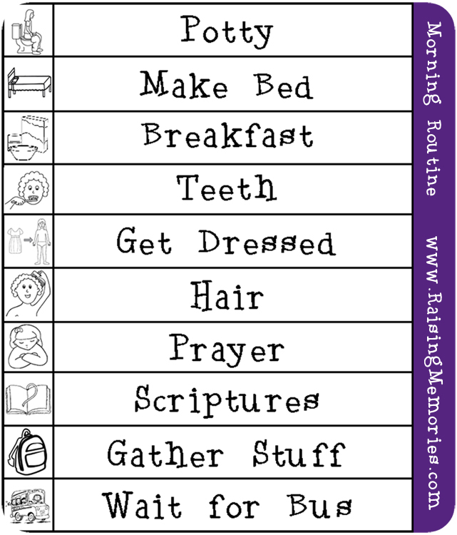
RESPECT
Priority- Is God Your #1…….???????
Luke 12:34- ³⁴ For where your treasure is, there will your heart be also.
Matthew 6:24- ²⁴ “No one can serve two masters; for either he will hate the one and love the other, or else he will be loyal to the one and despise the other. You cannot serve God and ^{[a]}mammon.
Luke 12:22-24- Then He said to His disciples, “Therefore I say to you, do not worry about your life, what you will eat; nor about the body, what you will put on. ²³ Life is more than food, and the body is more than clothing. ²⁴ Consider the ravens, for they neither sow nor reap, which have neither storehouse nor barn; and God feeds them. Of how much more value are you than the birds?

Slide 7
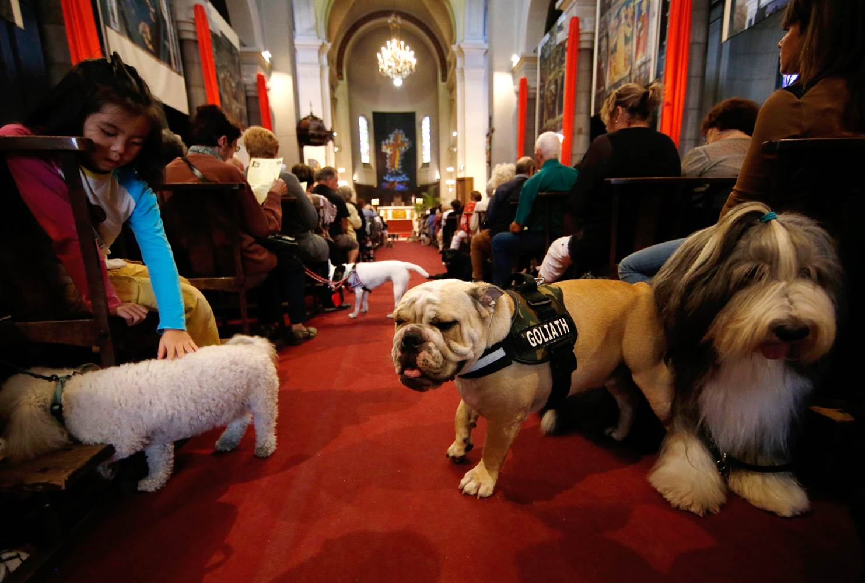
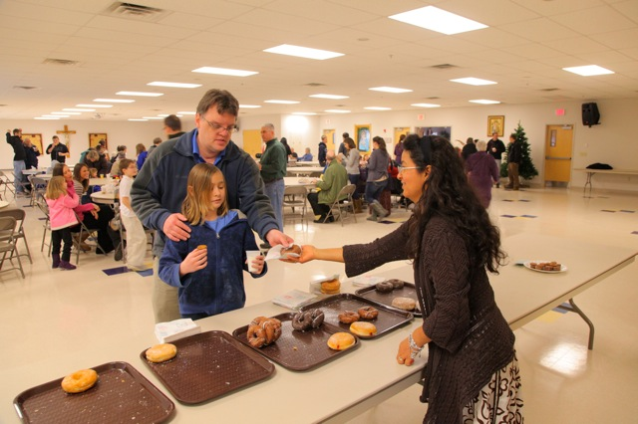
RESPECT
Entertainment
2 Timothy 3:16-17 ¹⁶ All Scripture is given by inspiration of God, and is profitable for doctrine, for reproof, for correction, for ^{[a]}instruction in righteousness, ¹⁷ that the man of God may be complete, thoroughly equipped for every good work.
Matthew 24:24 ²⁴For there shall arise false Christs, and false prophets, and shall shew great signs and wonders; insomuch that, if it were possible, they shall deceive the very elect.
Romans 14: 11-12 For it is written:“As I live, says the Lord,Every knee shall bow to Me,And every tongue shall confess to God.”¹² So then each of us shall give account of himself to God.

Slide 8
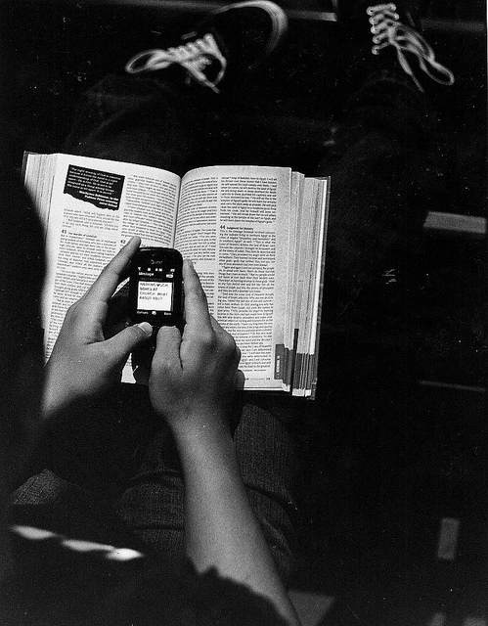
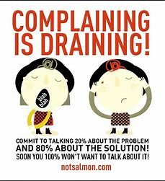
RESPECT
Complaining
Philippians 2:14 - Do all things without murmurings and disputings:
Ephesians 4:29 - Let no corrupt communication proceed out of your mouth, but that which is good to the use of edifying, that it may minister grace unto the hearers.
James 5:9 - Grudge not one against another, brethren, lest ye be condemned: behold, the judge standeth before the door.
1 Corinthians 10:10 - Neither murmur ye, as some of them also murmured, and were destroyed of the destroyer.

Slide 9
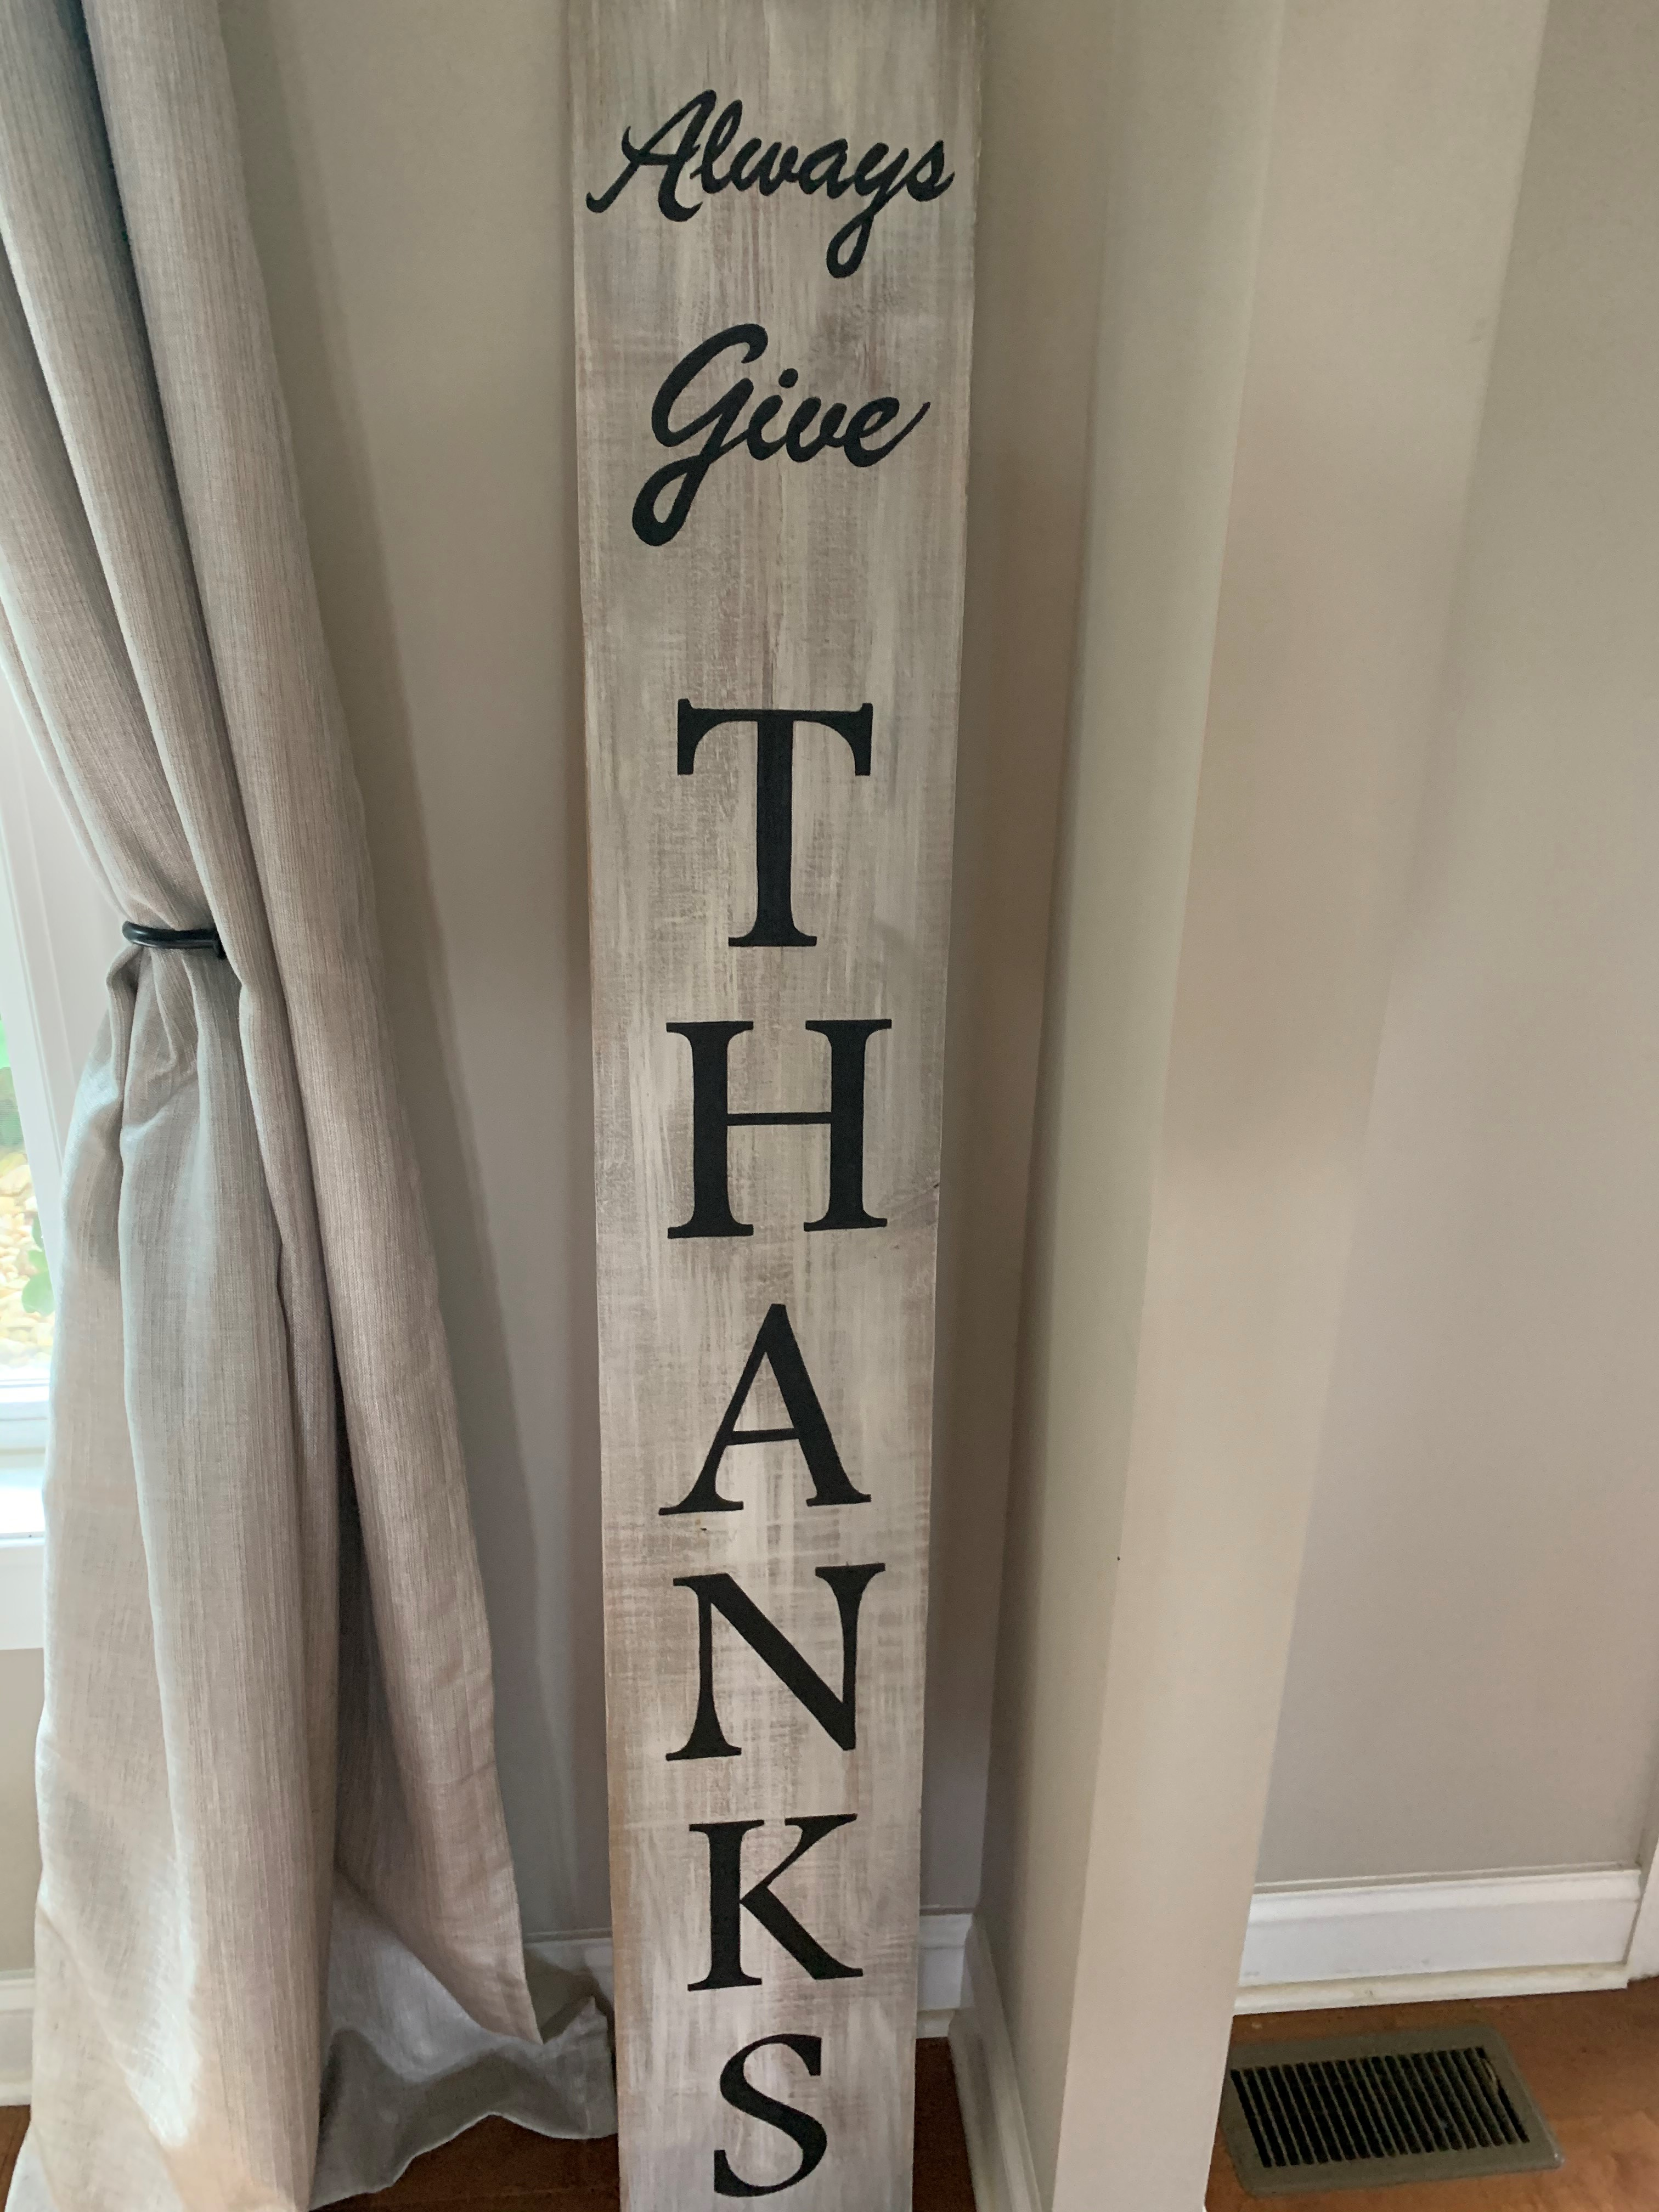
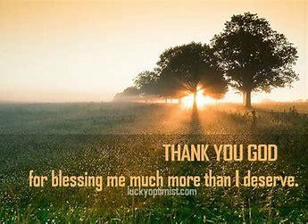
RESPECT
Thankful- Expressing Gratitude
Colossians 3:15- ¹⁵ And let the peace of God rule in your hearts, to which also you were called in one body; and be thankful.
Colossians 4:2 - ² Continue earnestly in prayer, being vigilant in it with thanksgiving;
Are you thankful? Do you teach your children to be thankful?
Do you thank God for all that he has given you? Jobs, home, children and most of all the opportunity of Heaven..
1 Thess. 5:16-18 ¹⁶ Rejoice always, ¹⁷ pray without ceasing, ¹⁸ in everything give thanks; for this is the will of God in Christ Jesus for you.

