Slide 1
The Blame Game
7-19-2020

Slide 2
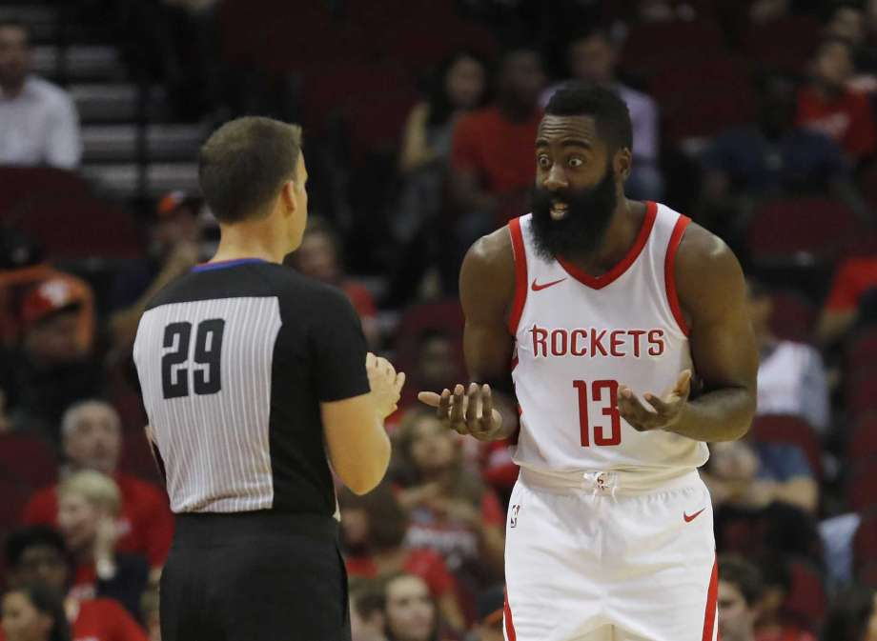
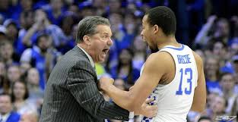

Slide 3
Avoid Blaming Ourselves
I. Conversations allude to other people causing our problems.
“ That’s how I am” or “ I can’t stop”
God can help us overcome any issue.
Phil. 4:13 I can do all things through Christ^{[a]} who strengthens me.
II. Do you feel that your living your Christian life to the fullest? Is your heart in the right place?

Slide 4
Some don’t even attempt
Continuously late for services
Out of control temper
No interest in Christian studies, avoid gatherings
Home in disarray..
Constantly negative, complain
Alcohol
Envy
Worry
Moodiness
Worldly
These are controllable. That’s to say “ If we really want to”

Slide 5
Shifting Blame
Philippians 2:13- For it is God who works in you both to will and to do for His good pleasure.
It is so easy for us to lay the blame on others..
Genesis 3:12- ¹²The man said, "The woman you put here with me-she gave me some fruit from the tree, and I ate it."
Genesis 4:9- Then the Lord said to Cain, “Where is Abel your brother?” He said, “I do not know. Am I my brother’s keeper?”
Luke 14:16-20- not attending
Luke 19:20-21- ¹⁹ “His master answered, ‘You take charge of five cities.’²⁰ “Then another servant came and said, ‘Sir, here is your mina; I have kept it laid away in a piece of cloth.
blamed another for his inability

Slide 6
What we blame (Our Environment)
I’m late because of (people, kids, mail, too rushed)
It’s too cold for church, AC isn’t working??
I’m not having the covered dish, not clean, small , expense
I lost my cool because I’ve been sick or not feeling well.
If I had as much money as her/him ??????
Why do we have so many gospel meetings? These dates are at the worst possible time
Does he ever review his lesson?
John 17:15-16 I do not pray that You should take them out of the world, but ^{b}that You should keep them from the evil one. ¹⁶ They are not of the world, just as I am not of the world.

Slide 7
Our Past
We blame our inability from things in the past, childhood, marital issues, relationship with another member
This may be who you were, but not what you can be..
Philippians 2:12- Therefore, my beloved, as you have always obeyed, not as in my presence only, but now much more in my absence, work out your own salvation with fear and trembling;

Slide 8
Satan
He is the chief tempter for Christians
We must not blame him for our actions
I Corinthians 10:13 No temptation has overtaken you except such as is common to man; but God is faithful, who will not allow you to be tempted beyond what you are able, but with the temptation will also make the way of escape, that you may be able to bear it.
You can overcome it, it’s your choice..

Slide 9
Don’t blame anyone just fix the problem
I. We focus on why we have problems
“I get upset because my children won’t listen too me”
Problem 1- I get upset
Problem 2- children won’t listen
Until we understand that we have the problem, it will never get fixed.
II. God will help you examine your problem (test, train, educate)
1- II Cor. 13:5 Examine yourselves as to whether you are in the faith. Test yourselves. Do you not know yourselves, ^{k}that Jesus Christ is in you?—unless indeed you²are disqualified.
2- Hebrews 5:14 But solid food belongs to those who are ³of full age, that is, those who by reason of ⁴use have their senses exercised ^{s}to discern both good and evil
3- Ephesians 5:15 See then that you walk circumspectly, not as fools but as wise,

Slide 10
Make the Change
Ephesians 4:25-32 Therefore, putting away lying, ^{c}“Let each one of you speak truth with his neighbor,” for ^{d}we are members of one another. ^{26 e}“Be angry, and do not sin”: do not let the sun go down on your wrath, ^{27 f}nor give ⁷place to the devil. ²⁸ Let him who stole steal no longer, but rather ^{g}let him labor, working with his hands what is good, that he may have something ^{h}to give him who has need. ^{29 i}Let no corrupt word proceed out of your mouth, but ^{j}what is good for necessary ⁸edification, ^{k}that it may impart grace to the hearers. ³⁰ And ^{l}do not grieve the Holy Spirit of God, by whom you were sealed for the day of redemption. ^{31 m}Let all bitterness, wrath, anger, ⁹clamor, and ^{n}evil speaking be put away from you, ºwith all malice. ³² And ^{p}be kind to one another, tenderhearted, ^{q}forgiving one another, even as God in Christ forgave you.
Make the commitment to change – James 1:22 But be doers of the word, and not hearers only, deceiving yourselves.
Trust in God.
II Cor. 4:16 Therefore we ^{y}do not lose heart. Even though our outward man is perishing, yet the inward man is ^{z}being renewed day by day.

Slide 11
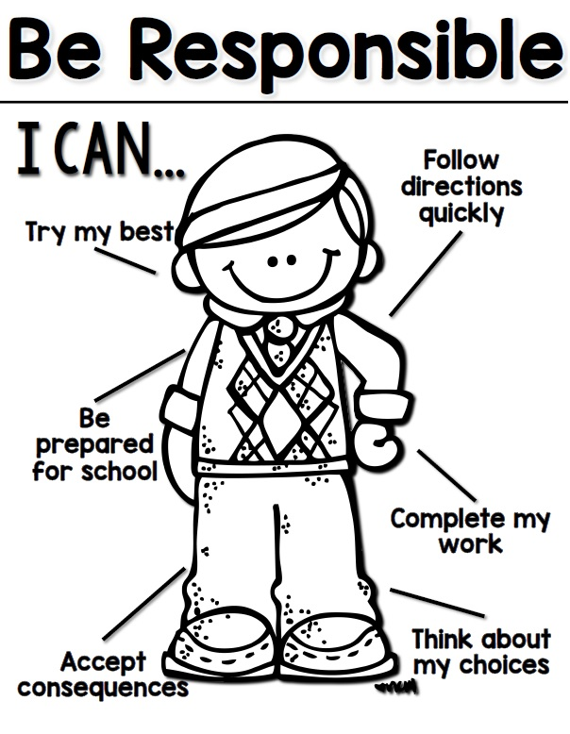
Conclusion
Don’t blame others for:
Poor attendance
Daily Bible Study
Teaching your children
Class study
We have to serve God to the best of our ability to have the hope of Heaven..
Romans 14:12-13- So then each of us shall give account of himself to God. ¹³ Therefore let us not judge one another ^{[a]}anymore, but rather resolve this, not to put a stumbling block or a cause to fall in our brother’s way.

