Slide 1
Scripture Reading
Galatians 5:22-26 King James Version (KJV)
²² But the fruit of the Spirit is love, joy, peace, longsuffering, gentleness, goodness, faith,
²³ Meekness, temperance: against such there is no law.
²⁴ And they that are Christ's have crucified the flesh with the affections and lusts.
²⁵ If we live in the Spirit, let us also walk in the Spirit.
²⁶ Let us not be desirous of vain glory, provoking one another, envying one another.

Slide 2
You Need Some Fruit In Your Diet

Slide 3
Who Are You?

Slide 4
What kind of Christian do people think I am?

Slide 5
Works of the Flesh (Gal. 5:16-22)
16 I say then: Walk in the Spirit, and you shall not fulfill the lust of the flesh.17 For the flesh lusts against the Spirit, and the Spirit against the flesh; and these are contrary to one another, so that you do not do the things that you wish.18 But if you are led by the Spirit, you are not under the law.19 Now the works of the flesh are evident, which are: adultery, fornication, uncleanness, lewdness,20 idolatry, sorcery, hatred, contentions, jealousies, outbursts of wrath, selfish ambitions, dissensions, heresies,21 envy, murders, drunkenness, revelries, and the like; of which I tell you beforehand, just as I also told you in time past, that those who practice such things will not inherit the kingdom of God.

Slide 6
Fruit of the Spirit (Gal. 5:22-23)
Love- an intense feeling of deep affection.
Jesus- Ultimate example of love.. John 3:16 ¹⁶ For God so loved the world that He gave His only begotten Son, that whoever believes in Him should not perish but have everlasting life.
1 Cor. 13:4-5- ⁴ Love suffers long and is kind; love does not envy; love does not parade itself, is not ^{[a]}puffed up; ⁵ does not behave rudely, does not seek its own, is not provoked, ^{[b]}thinks no evil;
Fornication, uncleanness, lewdness and adultery- deceptive love
Hatred, contentions, jealousies, wrath, selfish ambitions, dissensions, heresies, envy, murder- exact opposite of love
Sorcery & idolatry- deceptive love towards our God
Revelries and Drunkeness- sorrowful attempts to fill the empty space that only love can fill.
Joy- a feeling of great pleasure and happiness.
Prodigal Son- Luke 15:32 ³² It was right that we should make merry and be glad, for your brother was dead and is alive again, and was lost and is found.’”

Slide 7
Fruit of the Spirit
Peace- freedom from disturbance; quiet and tranquility.
John 16:33 “These things I have spoken unto you, that in me ye might have peace. In the world ye shall have tribulation: but be of good cheer; I have overcome the world.” Matthew 5:9 - Blessed [are] the peacemakers: for they shall be called the children of God.
A peacemaker is someone who experiences the peace of God (Philippians 4:7) because he is at peace (Romans 5:1) with the God of peace (Philippians 4:9) through the Prince of peace (Isaiah 9:6), who, indeed, is our peace (Ephesians 2:14), and who therefore seeks to live at peace with all others (Romans 12:18) and proclaims the gospel of peace (Ephesians 6:15) so that others might have joy and peace in believing (Romans 15:13).
Long suffering-having or showing patience in spite of troubles, especially those caused by other people.
David- 1 Samuel 31. Wronged by Saul, wrong by Absolom
1 Cor. 10:13 ¹³ No temptation has overtaken you except such as is common to man; but God is faithful, who will not allow you to be tempted beyond what you are able, but with the temptation will also make the way of escape, that you may be able to bear it.

Slide 8
Fruit of the Spirit
Gentleness- the quality of being kind, tender, or mild-mannered.
Paul- I Thess.2:7 ⁷ But we were gentle among you, just as a nursing mother cherishes her own children.
Gentleness is a strong hand with a soft touch
A gentle person speaks the truth in a way others can receive.
Goodness- the nutritious, flavorful, or beneficial part of something.
God is the source of everything that is good:
Every good thing bestowed and every perfect gift is from above, coming down from the Father of lights, with whom there is no variation, or shifting shadow (James 1:17).
Full of generosity…

Slide 9
Fruit of the Spirit
Faith- complete trust or confidence in someone or something.
Hebrews 11:1 -Now faith is the substance of things hoped for, the evidence of things not seen.
Hebrews 11- Abel, Enoch, Noah, Abraham, Sarah, Isaac, Jacob, Joseph & Moses.
By faith “ your name” was ??
Meekness- the fact or condition of being meek; submissiveness. enduring injury with patience and without resentment.
Moses - Numbers 12: 1-3 Then Miriam and Aaron spoke against Moses because of the Ethiopian woman whom he had married; for he had married an Ethiopian woman. ² So they said, “Has the Lord indeed spoken only through Moses? Has He not spoken through us also?” And the Lord heard it. ³ (Now the man Moses was very humble, more than all men who were on the face of the earth.)

Slide 10
Fruit of the Spirit
Temperance- moderation in action, thought, or feeling.
Daniel, Hananiah, Mishael and Azariah are four more youths that demonstrated incredible mastery over themselves (Daniel 1). These four teens were brought from Palestine to Babylon by Nebuchadnezzar. His intent was to train them for service in the government. One aspect of their training involved their diet which was provided from the king’s table. For some reason this food and drink was regarded as unclean by Jews. It may have been unclean because of the kind of food it was, or it may have been so because it had been offered to idols (Leviticus 11; cf. I Corinthians 8) The drink may have been rejected because it was intoxicating (Proverbs 23:31; Isaiah 5:11, 22).
Jesus- The Holy Spirit led Jesus into the wilderness to be tempted of the devil. The test began in earnest after Jesus had fasted for forty days and nights. Having had no food and no water Jesus was hungry (Matthew 4: 2). In this time of weakness, Satan came and tempted Jesus to turn stones into bread. But, our Lord refused because man does not live by bread alone, but by every word that proceeds from the mouth of God (Luke 4:4).
How do you react when something doesn’t go your way? Do we resort to the world for guidance? social media, gossip, hatred, back talk..
Remember: The flesh wants to please itself.

Slide 11
Title Layout
Subtitle

Slide 12
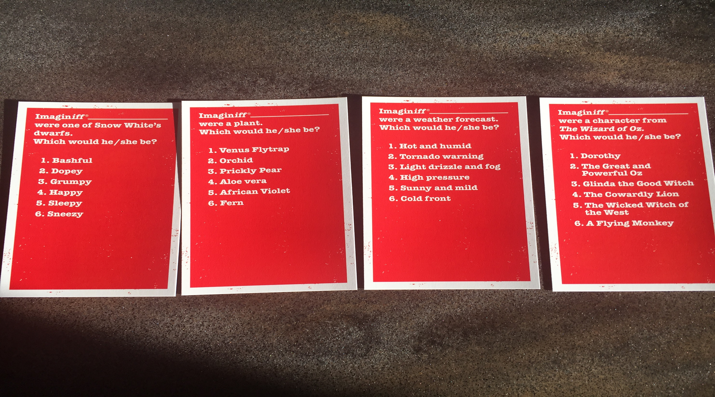
Imagine Iff

