Slide 1
Planting A Seed
West Main Street September 13th, 2020

Slide 2
Scripture Reading
Matthew 13:24-30- ²⁴ Here is another story Jesus told: “The Kingdom of Heaven is like a farmer who planted good seed in his field. ²⁵ But that night as the workers slept, his enemy came and planted weeds among the wheat, then slipped away. ²⁶ When the crop began to grow and produce grain, the weeds also grew.
²⁷ “The farmer’s workers went to him and said, ‘Sir, the field where you planted that good seed is full of weeds! Where did they come from?’
²⁸ “‘An enemy has done this!’ the farmer exclaimed.
“‘Should we pull out the weeds?’ they asked.
²⁹ “‘No,’ he replied, ‘you’ll uproot the wheat if you do. ³⁰ Let both grow together until the harvest. Then I will tell the harvesters to sort out the weeds, tie them into bundles, and burn them, and to put the wheat in the barn.’”

Slide 3
Planting A Seed of
Confusion
Ignorance
Kindness
Hope

Slide 4
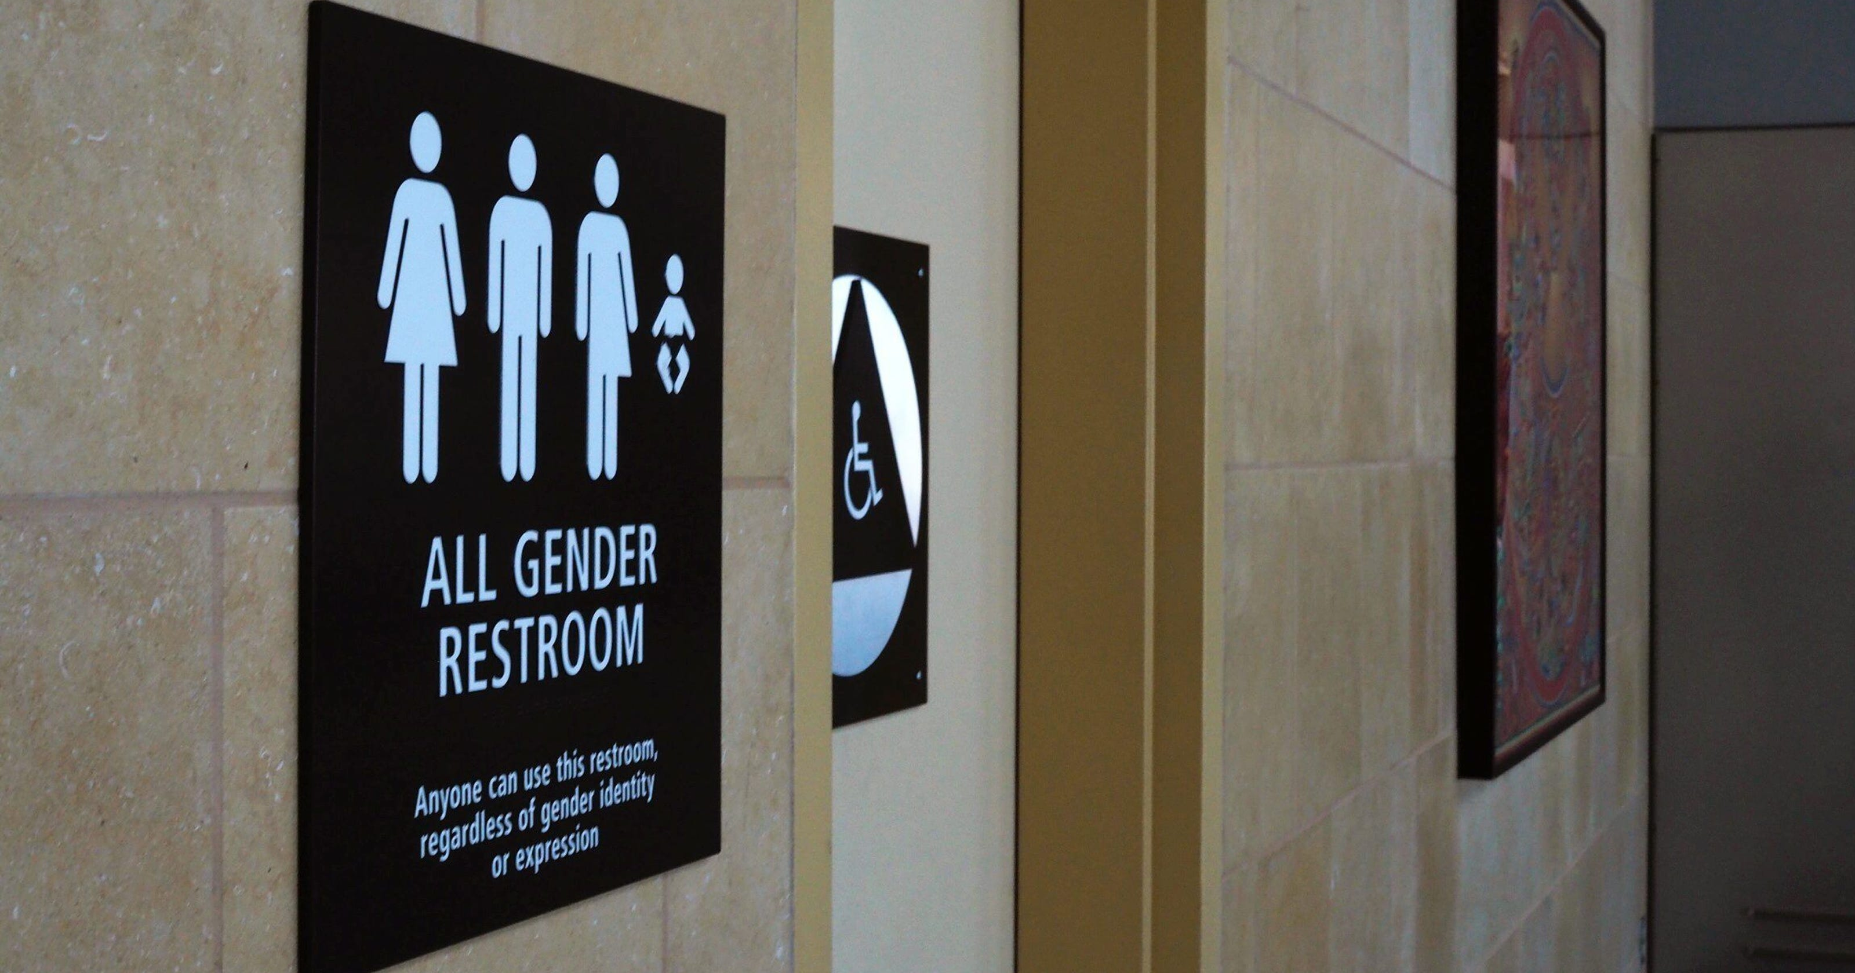
Confusion

Slide 5
Planting A Seed of: Confusion
“Confusion and mistakes come when we forget the importance of God’s Word as our unwavering guide.”
1 Cor. 14:33- For God is not the author of confusion but of peace, as in all the churches of the saints.
Genesis 3:1- Now the serpent was more cunning than any beast of the field which the Lord God had made. And he said to the woman, “Has God indeed said, ‘You shall not eat of every tree of the garden’?
You really think that’s going to happen? Those are only stories. False teachers may aid in this effort. You give members mixed signals.
What about this person? Why do they support this? We can go here tonight..

Slide 6
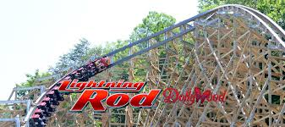
Planting A Seed of: Ignorance

Slide 7
Planting A Seed of: Ignorance
Lack of knowledge.
2 Cor. 2:11- ¹¹ lest Satan should take advantage of us; for we are not ignorant of his devices.
Ephesians 4:18- They are darkened in their understanding and separated from the life of God because of the ignorance that is in them due to the hardening of their hearts. (NIV) (Continue to live life in sin) We become callus.
Matthew 15:8-9- ‘These people draw near to Me with their mouth, And honor Me with their lips, But their heart is far from Me.⁹ And in vain they worship Me, Teaching as doctrines the commandments of men.’ ”
We must make sure that we right with God. We may think that we outsmarting, deceiving or portraying a perfect relationship on the outside as God knows our hearts.

Slide 8
Planting A Seed of: Kindness

Slide 9
Planting A Seed of: Kindness
Titus 3:3-7 - For we ourselves were also once foolish, disobedient, deceived, serving various lusts and pleasures, living in malice and envy, hateful and hating one another. ⁴ But when the kindness and the love of God our Savior toward man appeared, ⁵ not by works of righteousness which we have done, but according to His mercy He saved us, through the washing of regeneration and renewing of the Holy Spirit, ⁶ whom He poured out on us abundantly through Jesus Christ our Savior, ⁷ that having been justified by His grace we should become heirs according to the hope of eternal life.
How can live this life as enemies, if we are Christians? We need to pray and ask God for forgiveness so we unify our LOVE for one another.
We must possess the right type of love in our life to show this kindness.
1 Cor. 13:4-5 - Love is patient and kind; love does not envy or boast; it is not arrogant ⁵ or rude. It does not insist on its own way; it is not irritable or resentful;

Slide 10
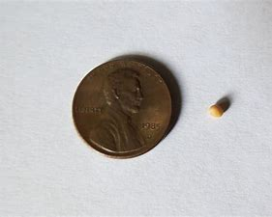
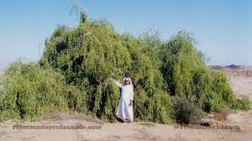
Planting A Seed of: Hope
Mark 4:30-32 Then He said, “To what shall we liken the kingdom of God? Or with what parable shall we picture it? 31 It is like a mustard seed which, when it is sown on the ground, is smaller than all the seeds on earth; 32 but when it is sown, it grows up and becomes greater than all herbs, and shoots out large branches, so that the birds of the air may nest under its shade.”

Slide 11
Planting A Seed of: Hope
What do you expect the future to bring?
Romans 15:4- For whatever things were written before were written for our learning, that we through the ^{[a]}patience and comfort of the Scriptures might have hope.
II Thess. 2:16-17 - ¹⁶ Now may our Lord Jesus Christ Himself, and our God and Father, who has loved us and given us everlasting consolation and good hope by grace, ¹⁷ comfort your hearts and ^{[a]}establish you in every good word and work.
Example:
a. Pessimist - “This place is terribly run. Look at the all problems here. It is no wonder we don’t grow.”
b. Optimist - “The fields are white to harvest. Go and visit and call someone today.”

Slide 12
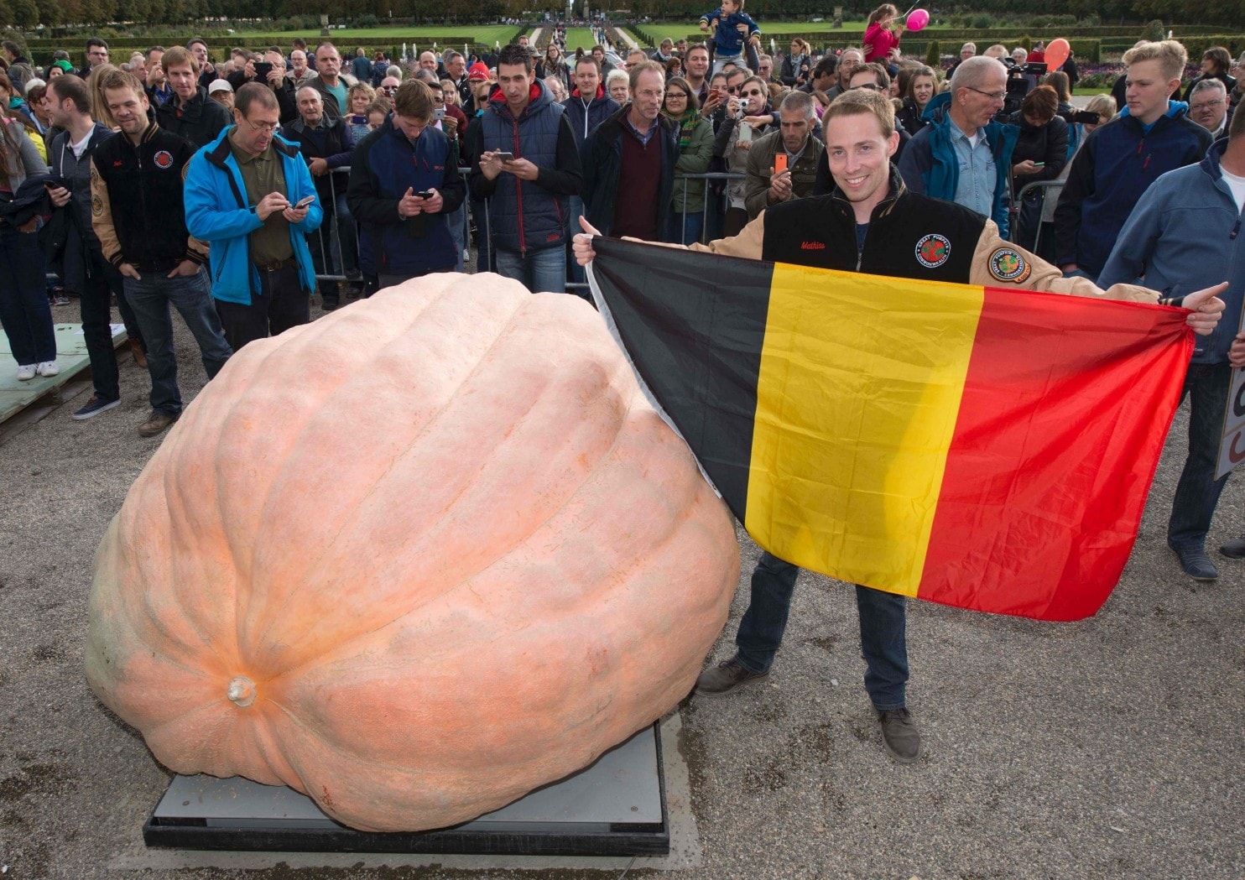
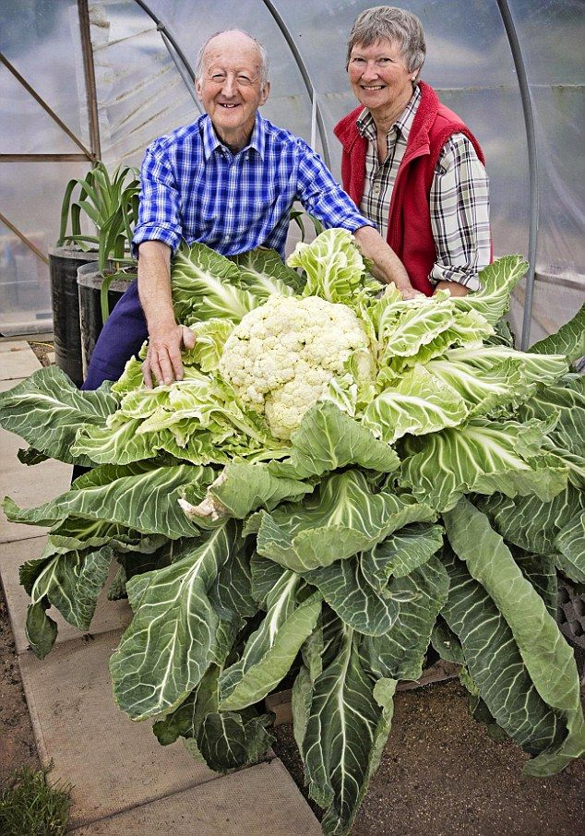
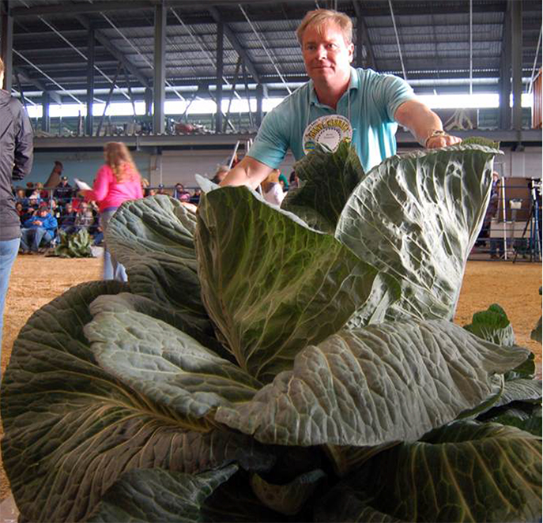
Conclusion
What seeds are you planting?
Would you really want to water them and watch them grow?
Do you look for different seeds?

