Slide 1
Scripture Reading
Matt. 13:10-17
10 And the disciples came, and said unto him, Why speakest thou unto them in parables? 11 He answered and said unto them, Because it is given unto you to know the mysteries of the kingdom of heaven, but to them it is not given. 12 For whosoever hath, to him shall be given, and he shall have more abundance: but whosoever hath not, from him shall be taken away even that he hath. 13 Therefore speak I to them in parables: because they seeing see not; and hearing they hear not, neither do they understand. 14 And in them is fulfilled the prophecy of Esaias, which saith, By hearing ye shall hear, and shall not understand; and seeing ye shall see, and shall not perceive: 15 For this people's heart is waxed gross, and their ears are dull of hearing, and their eyes they have closed; lest at any time they should see with their eyes, and hear with their ears, and should understand with their heart, and should be converted, and I should heal them. 16 But blessed are your eyes, for they see: and your ears, for they hear. 17 For verily I say unto you, That many prophets and righteous men have desired to see those things which ye see, and have not seen them; and to hear those things which ye hear, and have not heard them.

Slide 2
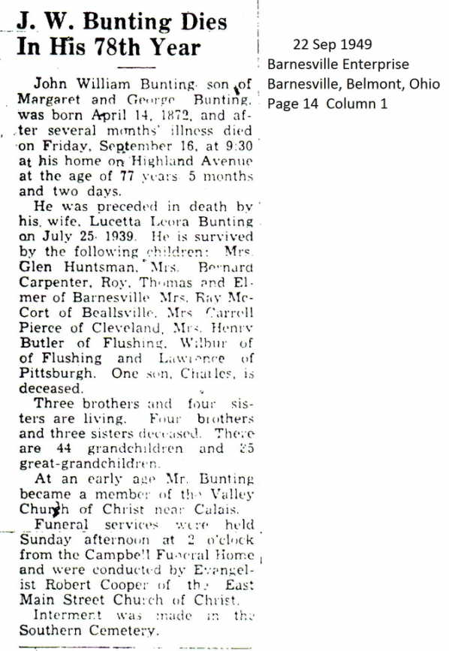
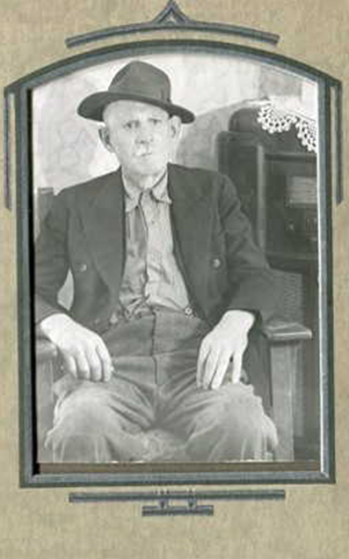
John Bunting
Notes:
I am at least a 5th Generation church of Christ Member(West Main Street, East Main Street, Sandy Ridge, Calais Church of Christ).

Slide 3
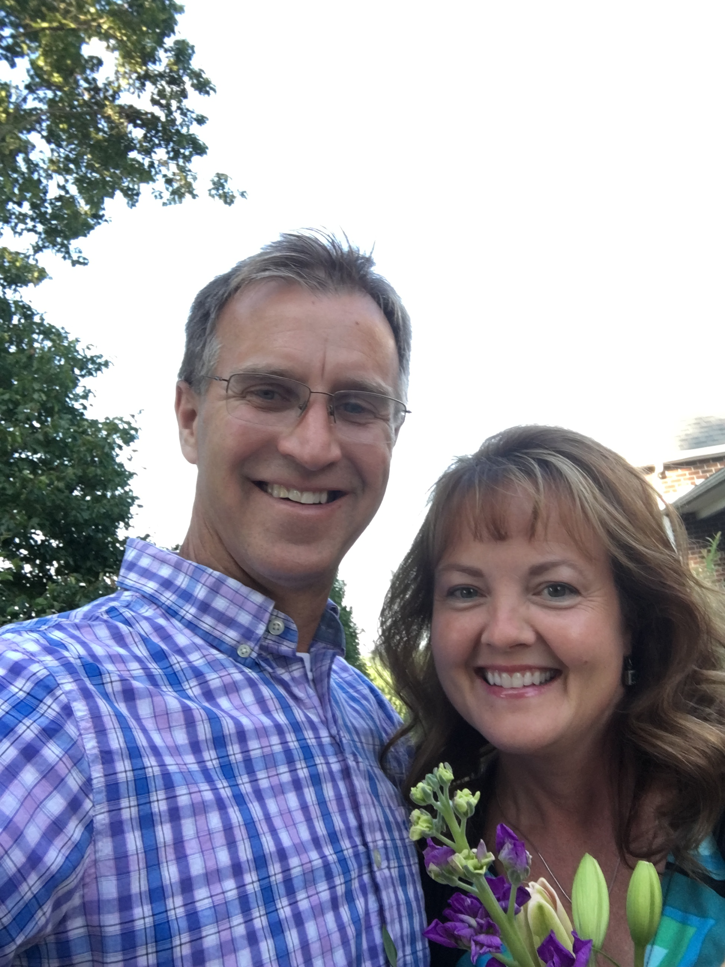

Lucetta Morris
Lucetta Bunting nee Morris
Source: from the Florence Wilson scrapbooks at the Barnesville, Ohio, Library; July, 1939
The death of Mrs. John W. Bunting highly esteemed Highland Ave. resident occurred at her home early Tuesday morning following an illness of several weeks.
Lucetta Morris Bunting, a daughter of Thomas and Caroline Morris was born Feb. 11, 1872 in Monroe County where she lived in early life. She had been a lifelong member of the Church of Christ and was zealous in her belief.
Almost 150 years
Notes:
I am at least a 5th Generation church of Christ Member(West Main Street, East Main Street, Sandy Ridge, Calais Church of Christ). Why is that? There are a lot different denominations. Is it because that was the way we were raised, because it was convenient. I would like to believe that is was something much bigger and important than that.

Slide 4
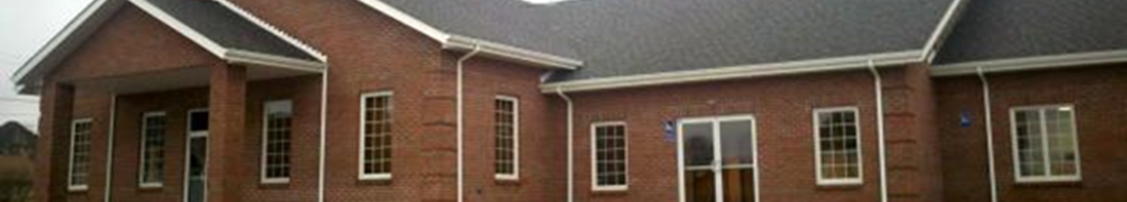
Introduction
I never questioned the truth I was taught when I was younger
I trusted my parents and the teachers and preachers
It wasn’t until I fell in love with someone who also loved the truth and believed what she was doing was right, did I truly began to dig and seek and question
There are many of our children who now find themselves in a similar position
Begin asking themselves “Does it really truly matter”?
4

Slide 5
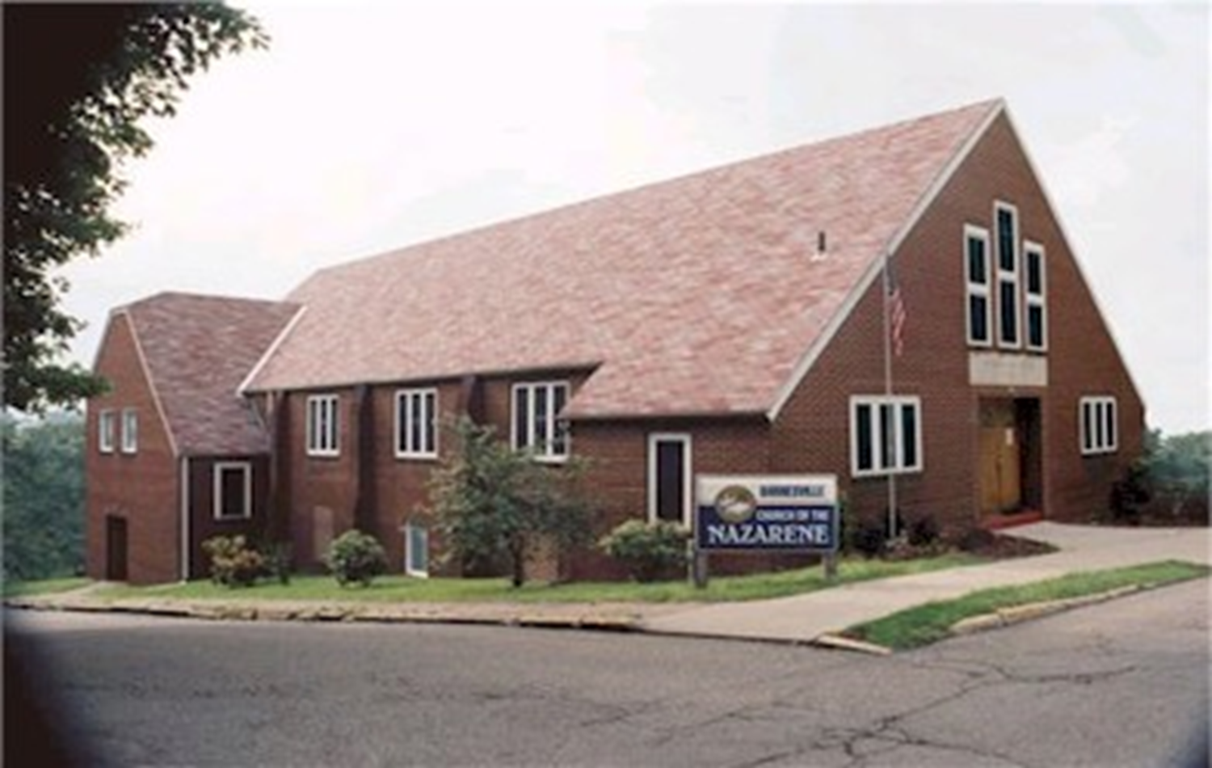
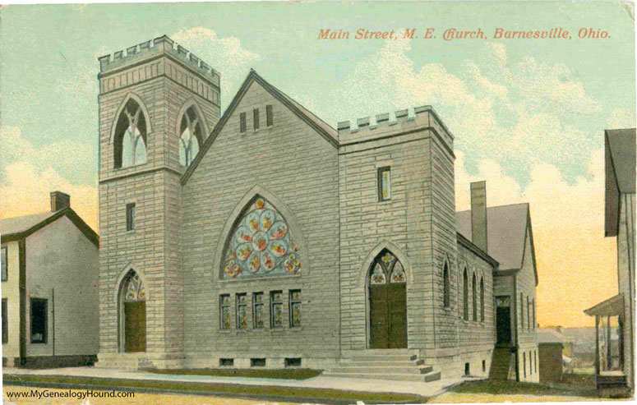
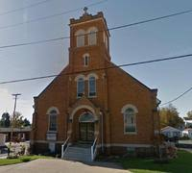
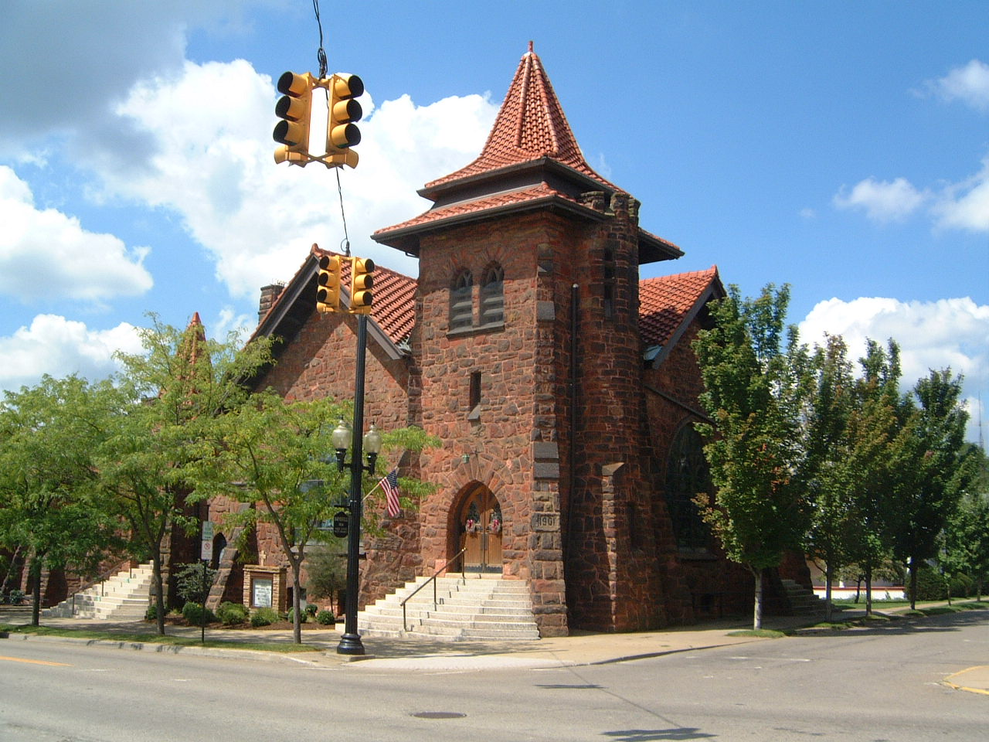
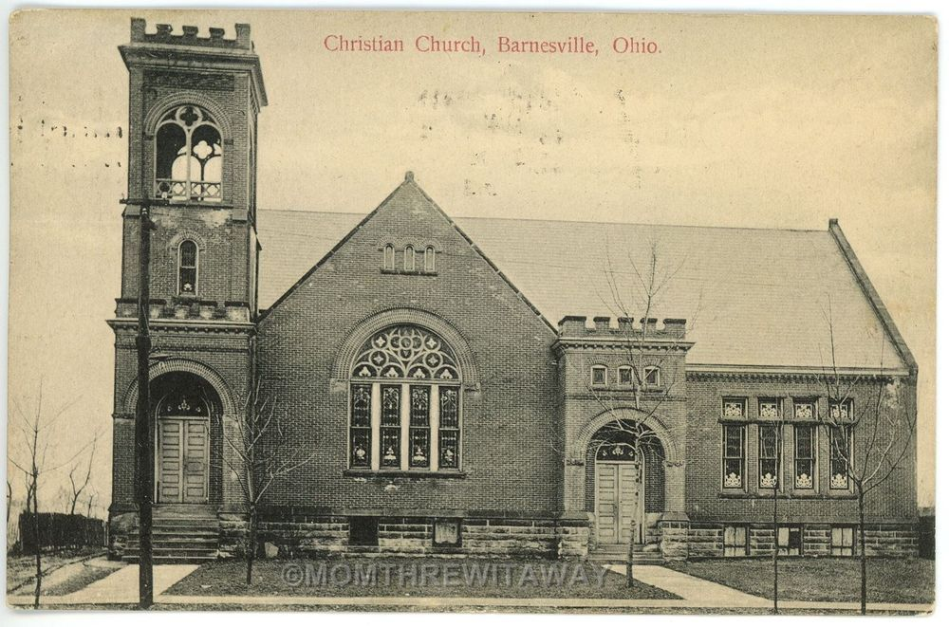
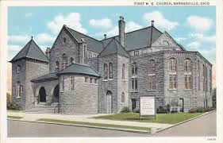
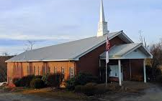
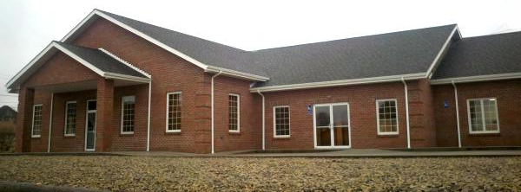
Does it Really Matter?
Notes:
What would services be like if you went somewhere else this morning? Presbyterian, Methodist, Catholic, Baptist, Christian Church: instrumental music, choir, coffee and donuts, Woman leading services, candles, social entertainment - basketball
Emphasize social gospel, missionary work, helping the poor

Slide 6
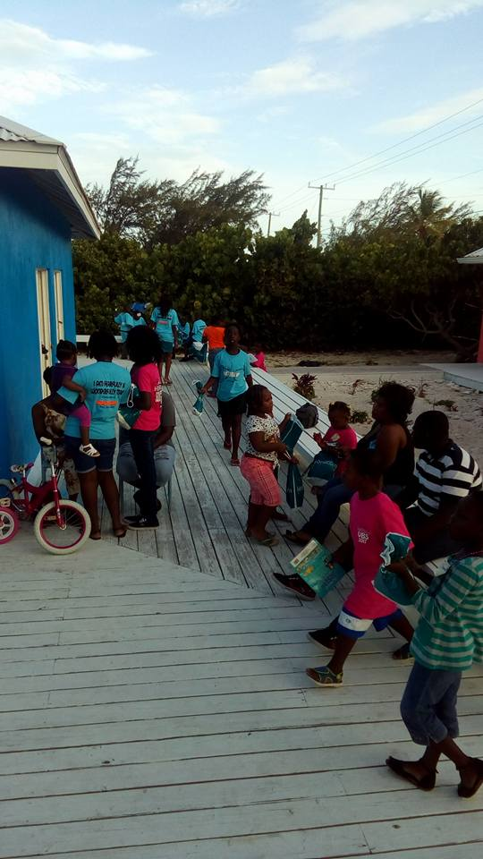

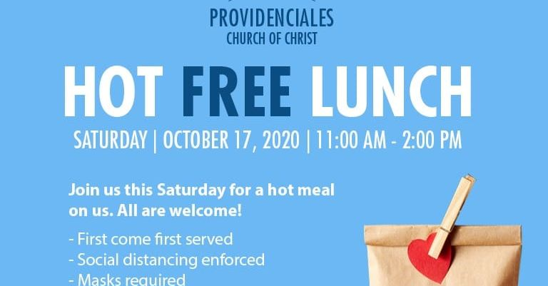
Turks and Caicos Church of Christ
Notes:
By our definition is a “liberal” Church of Christ.
Jacque Phanor is the preacher there. The experience was amazing. Conduct one service in (French or Spanish) and one in English. Remember the children and I remember the bible class. The subject of what the church can spend money on specifically helping the poor. Two times. Jesus fed the masses with loaves of bread and fishes on two occasions. The first was five loaves of bread and two fishes to five thousand men. The second was seven loaves and small fishes to four thousand men.
John 6:26 Jesus answered, "Very truly I tell you, you are looking for me, not because you saw the signs I performed but because you ate the loaves and had your fill.
Does it really matter? These are by our definition “good works”.

Slide 7
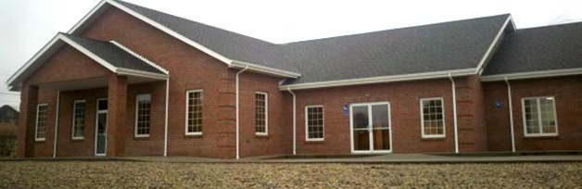
Does it Really Matter
Church of Christ
Liberal
Conservative
Baptist
Methodist
Christian Church
The importance that we attend the right church
The importance of the TRUTH and our desire for it
God’s attitude toward doing things right
God’s attitude toward details
Who will not be saved
Catholic
Notes:
Today we will not be studying what is the TRUTH and defining the right and wrong church. Today’s lesson is focused on the importance of finding the right church and that it does matter to God!

Slide 8
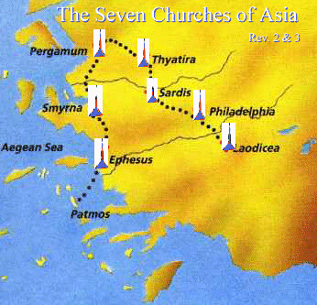
The seven churches
Does it Really Matter
Let all who have ears give heed to what the Spirit is saying to the Churches (Revelation 2:7,11,17, 29, 3:6, 13, 22).
EPHESUS -Doctrinal Zeal, But Duty Overrides Love!,
SMYRNA -Faithfulness, Even Through Tribulation and Material Poverty!
PERGAMON - Faithfulness, But a Toleration of False Teachings and Worldliness!
THYATIRA - Some Faithfulness, But Major Corruption!
SARDIS - A Spiritually Dead Congregation!
PHILADELPHIA - Faithful, Gospel-Preaching and Committed, Even Though Small in Strength!
LAODICEA - Wealthy....But Lukewarm!
Notes:
Ephesus. Nevertheless I have this against you, that you have left your first love.
Smyrna. -Be faithful until death, and I will give you the crown of life.
Pergamon. hold the doctrine of Balaam, who taught Balak to put a stumbling block before the children of Israel, to eat things sacrificed to idols, and to commit sexual immorality. 15 Thus you also have those who hold the doctrine of the Nicolaitans, [g]which thing I hate. 16 Repent, or else I will come to you quickly and will fight against them with the sword of My mouth.
Thyatira. “I know your works, love, [i]service, faith, and your [j]patience; and as for your works, the last are more than the first. 20 Nevertheless I have [k]a few things against you, because you allow [l]that woman Jezebel, who calls herself a prophetess, [m]to teach and seduce My servants to commit sexual immorality and eat things sacrificed to idols. …as many as do not have this doctrine, who have not known the depths of Satan, as they say, I [r]will put on you no other burden. 25 But hold fast what you have till I come.
Sardis. “I know your works, that you have a name that you are alive, but you are dead.
Philadelphia - Hold fast what you have, that no one may take your crown.
Laodicea. - 5 “I know your works, that you are neither cold nor hot. I could wish you were cold or hot. 16 So then, because you are lukewarm, and neither cold nor hot, I will vomit you out of My mouth.

Slide 9
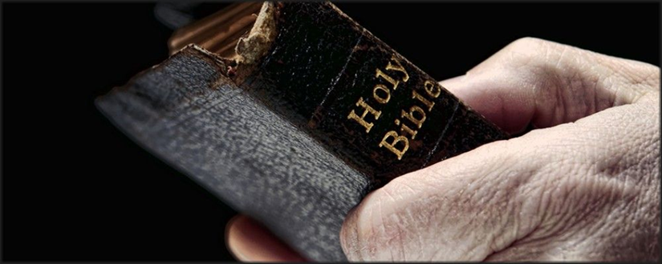
Truth?
Does it Really Matter
Joh 4:24 God is a Spirit: and they that worship him must worship him in spirit and in truth.
Joh 17:17 Sanctify them through thy truth: thy word is truth.
1Ti 3:15 But if I tarry long, that thou mayest know how thou oughtest to behave thyself in the house of God, which is the church of the living God, the pillar and ground of the truth.
Joh 8:32 And ye shall know the truth, and the truth shall make you free.
Notes:
The bible emphasizes the Truth and God wants us to worship in the right way. We MUST worship him in spirit and in TRUTH. The church is to be the pillar and ground of the TRUTH. The word is the TRUTH.

Slide 10

We should seek the truth & not our evidence
Does it Really Matter
We seek the truth in terms of our own will
Jas 1:14 But every man is tempted, when he is drawn away of his own lust, and enticed.
We look for evidence that supports our interpretation
2Pe 1:20 Knowing this first, that no prophecy of the scripture is of any private interpretation.
God expects us to discern the real truth
Ac 10:34 Then Peter opened his mouth, and said, Of a truth I perceive that God is no respecter of persons:

Slide 11
What is important and what is not?
Is water baptism necessary?
Is it wrong to drink alcohol?
What is God’s law concerning divorce and remarriage?
Can we sing with instrumental music?
Can we have a kitchen or fellowship hall?
Do we need to partake of the Lord’s Supper every week?
Can a woman lead a prayer, singing, or preach?
Does it matter how the church spends the Lord’s money?
Is missionary societies okay?
Can the church support schools, colleges, hospitals, missionary societies, orphan homes
2 Pet. 1:3 His divine power hath given unto us all things that pertain unto life and godliness, through the knowledge of Him that hath called us to glory and virtue.

Slide 12
Satan will deceive us to believe a lie
Does it Really Matter
1Jo 1:6 If we say that we have fellowship with him, and walk in darkness, we lie, and do not the truth:
Eph 4:14 That we henceforth be no more children, tossed to and fro, and carried about with every wind of doctrine, by the sleight of men, and cunning craftiness, whereby they lie in wait to deceive;
Ro 1:25 Who changed the truth of God into a lie, and worshipped and served the creature more than the Creator, who is blessed for ever. Amen.
Notes:
We believe lies because of our own selfish desires!!! Why? It is how I want or think it should be. Services are boring. We can draw people in with the Social Gospel.
We need to resist the devils temptations and stay obedient. It is important that we are part of a church who follows God according to TRUTH!

Slide 13

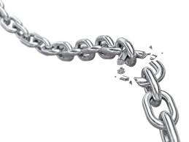
We need to seek the truth and believe ourselves
Does it Really Matter
Ro 14:11 For it is written, As I live, saith the Lord, every knee shall bow to me, and every tongue shall confess to God. 12 So then every one of us shall give account of himself to God.
Mt 12:36 But I say unto you, That every idle word that men shall speak, they shall give account thereof in the day of judgment.
Ga 6:5 For every man shall bear his own burden.
Notes:
We will all have to give account of ourselves! If you are not convicted in your heart and don’t truly seek the TRUTH then the path will change and the chain is broken. Your family will be impacted for generations!

Slide 14
God’s attitude toward doing things right
Does it Really Matter
Rom. 15:4 For whatsoever things were written aforetime were written for our learning, that we through patience and comfort of the scriptures might have hope.
The death penalty
Among these are sacrificing to a god other than Yahweh (Exodus 22:20), persistent rebelliousness on the part of a child (Deuteronomy 21:18–21), a child who hits or curses his or her parents (Exodus 21:15 and 17), working on the Sabbath (Exodus 35:2), premarital sexual intercourse (Deuteronomy 22:13–21), and the requirement for a priest to burn his daughter alive if she became a prostitute (Leviticus 21:9).
Notes:
The bible says the old testament was written for our learning. What does that mean? We don’t follow the laws, so what can we learn from it? We can learn about God! You can learn a lot about someone by watching what is important to them. I learn this about my Dad. Working on car: stay away when he is working on a car, stop when he says to stop, and don’t try to run away.

Slide 15
God’s attitude toward doing things right
Does it Really Matter
Rom. 15:4 For whatsoever things were written aforetime were written for our learning, that we through patience and comfort of the scriptures might have hope.
God’s anger and wrath
In 2 Samuel 24, we find that King David decided to take a census of the men of fighting age. The prophet Gad was sent to David to announce God’s displeasure with the taking of the census. The punishment for David’s sin: “The Lord sent a pestilence on Israel from that morning until the appointed time; and seventy thousand of the people died” (2 Samuel 24:15).
David makes a decision that does not please God, and God kills 70,000 Israelites for it? How could this action ever be reconciled with a God of mercy, compassion, justice, and love?
Notes:
When God tells us not to do something he means it! God is loving, but God means what He says!
Parents will sometimes say to their kids “ I really mean it”. This time?

Slide 16
God’s attitude toward details
The Individual Sin Offering
Rom. 15:4 For whatsoever things were written aforetime were written for our learning, that we through patience and comfort of the scriptures might have hope.
Leviticus 5:
5 When any of you sin in that you have heard a public adjuration to testify and—though able to testify as one who has seen or learned of the matter—do not speak up, you are subject to punishment. ²Or when any of you touch any unclean thing—whether the carcass of an unclean beast or the carcass of unclean livestock or the carcass of an unclean swarming thing—and are unaware of it, you have become unclean, and are guilty. ³Or when you touch human uncleanness—any uncleanness by which one can become unclean—and are unaware of it, when you come to know it, you shall be guilty. ⁴Or when any of you utter aloud a rash oath for a bad or a good purpose, whatever people utter in an oath, and are unaware of it, when you come to know it, you shall in any of these be guilty. ⁵When you realize your guilt in any of these, you shall confess the sin that you have committed. ⁶And you shall bring to the Lord, as your penalty for the sin that you have committed, a female from the flock, a sheep or a goat, as a sin-offering; and the priest shall make atonement on your behalf for your sin.
7 But if you cannot afford a sheep, you shall bring to the Lord, as your penalty for the sin that you have committed, two turtle-doves or two pigeons, one for a sin-offering and the other for a burnt-offering. ⁸You shall bring them to the priest, who shall offer first the one for the sin-offering, wringing its head at the nape without severing it. ⁹He shall sprinkle some of the blood of the sin-offering on the side of the altar, while the rest of the blood shall be drained out at the base of the altar; it is a sin-offering. ¹⁰And the second he shall offer for a burnt-offering according to the regulation. Thus the priest shall make atonement on your behalf for the sin that you have committed, and you shall be forgiven. 11 But if you cannot afford two turtle-doves or two pigeons, you shall bring as your offering for the sin that you have committed one-tenth of an ephah of choice flour for a sin-offering; you shall not put oil on it or lay frankincense on it, for it is a sin-offering. ¹²You shall bring it to the priest, and the priest shall scoop up a handful of it as its memorial portion, and turn this into smoke on the altar, with the offerings by fire to the Lord; it is a sin-offering. ¹³Thus the priest shall make atonement on your behalf for whichever of these sins you have committed, and you shall be forgiven. Like the grain-offering, the rest shall be for the priest.
Notes:
Look at how specific God was when a sin was committed. He had provisions for those who had a lot of money and even those who couldn’t afford a couple of birds. Does this sound like a God who doesn’t care how we worship or serve him.
Prov. 21:3 (NIV) To do what is right and just is more acceptable to the LORD than sacrifice.

Slide 17
God’s attitude toward details
Rom. 15:4 For whatsoever things were written aforetime were written for our learning, that we through patience and comfort of the scriptures might have hope.
The Priest Sin Offering
Leviticus 4:
3 If it is the anointed priest who sins, thus bringing guilt on the people, he shall offer for the sin that he has committed a bull of the herd without blemish as a sin-offering to the Lord. 4He shall bring the bull to the entrance of the tent of meeting before the Lord and lay his hand on the head of the bull; the bull shall be slaughtered before the Lord. 5The anointed priest shall take some of the blood of the bull and bring it into the tent of meeting. 6The priest shall dip his finger in the blood and sprinkle some of the blood seven times before the Lord in front of the curtain of the sanctuary. 7The priest shall put some of the blood on the horns of the altar of fragrant incense that is in the tent of meeting before the Lord; and the rest of the blood of the bull he shall pour out at the base of the altar of burnt-offering, which is at the entrance of the tent of meeting. 8He shall remove all the fat from the bull of sin-offering: the fat that covers the entrails and all the fat that is around the entrails; 9the two kidneys with the fat that is on them at the loins; and the appendage of the liver, which he shall remove with the kidneys, 10just as these are removed from the ox of the sacrifice of well-being. The priest shall turn them into smoke upon the altar of burnt-offering. 11But the skin of the bull and all its flesh, as well as its head, its legs, its entrails, and its dung— 12all the rest of the bull—he shall carry out to a clean place outside the camp, to the ash heap, and shall burn it on a wood fire; at the ash heap it shall be burned.
Notes:
Look at how specific God was with had to be done if an anointed priest would sin.
Prov. 21:3 (NIV) To do what is right and just is more acceptable to the LORD than sacrifice.

Slide 18
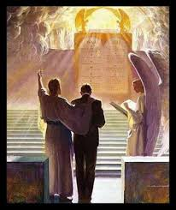
Many will not be saved who expect to be saved
Matt 7:13, 21-23 and Luke 13:25-27 makes this fact clear, and these are the words of the Lord Jesus! The reference is to those who profess to know Him but who do not in fact know Him at all.
Matt 7:13 “Enter by the narrow gate; for wide is the gate and broad is the way that leads to destruction, and there are many who go in by it.
Matt 7:21 “Not everyone who says to Me, ‘Lord, Lord,’ shall enter the kingdom of heaven, but he who does the will of My Father in heaven. 22 Many will say to Me in that day, ‘Lord, Lord, have we not prophesied in Your name, cast out demons in Your name, and done many wonders in Your name?’ 23 And then I will declare to them, ‘I never knew you; depart from Me, you who practice lawlessness!’
Luke 13:25-27
25 When once the Master of the house has risen up and shut the door, and you begin to stand outside and knock at the door, saying, ‘Lord, Lord, open for us,’ and He will answer and say to you, ‘I do not know you, where you are from,’ 26 then you will begin to say, ‘We ate and drank in Your presence, and You taught in our streets.’ 27 But He will say, ‘I tell you I do not know you, where you are from. Depart from Me, all you workers of iniquity.’
Notes:
How tragic it is to expect to be saved, to think that you are saved and in the end to find that you are not!
How many people there are like this! They expect to be saved because they go to church, because they have been baptized, because they say their prayers, because they are charitable, because they kind and loving. It is not going to be enough. There will be many like this.
Titus 1:16. 16 They profess to know God, but in works they deny Him, being abominable, disobedient, and disqualified for every good work.
Eph. 2:8 For by grace you have been saved through faith, and that not of yourselves; it is the gift of God, 9 not of works, lest anyone should boast. 10 For we are His workmanship, created in Christ Jesus for good works, which God prepared beforehand that we should walk in them.

Slide 19
Does it Really Matter?
Notes:
Does it really matter? Yes it does. God is a serious God. He expects us to do what he says. He has laid out for us what His church should be and do.
We must listen to him. You have to be committed and convicted in your heart to seek the TRUTH, to follow it, to live by it.

Slide 20
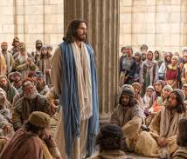
Jesus Said: John 14
14 Let not your heart be troubled: ye believe in God, believe also in me. 2 In my Father's house are many mansions: if it were not so, I would have told you. I go to prepare a place for you. 3 And if I go and prepare a place for you, I will come again, and receive you unto myself; that where I am, there ye may be also. 4 And whither I go ye know, and the way ye know. 5 Thomas saith unto him, Lord, we know not whither thou goest; and how can we know the way? 6 Jesus saith unto him, I am the way, the truth, and the life: no man cometh unto the Father, but by me.

