Slide 1
Scripture Reading
Mark 2:13-17- 13 Then He went out again by the sea; and all the multitude came to Him, and He taught them. 14 As He passed by, He saw Levi the son of Alphaeus sitting at the tax office. And He said to him, “Follow Me.” So he arose and followed Him.
15 Now it happened, as He was dining in Levi’s house, that many tax collectors and sinners also sat together with Jesus and His disciples; for there were many, and they followed Him. 16 And when the scribes and Pharisees saw Him eating with the tax collectors and sinners, they said to His disciples, “How is it that He eats and drinks with tax collectors and sinners?”
17 When Jesus heard it, He said to them, “Those who are well have no need of a physician, but those who are sick. I did not come to call the righteous, but sinners, to repentance.”

Slide 2
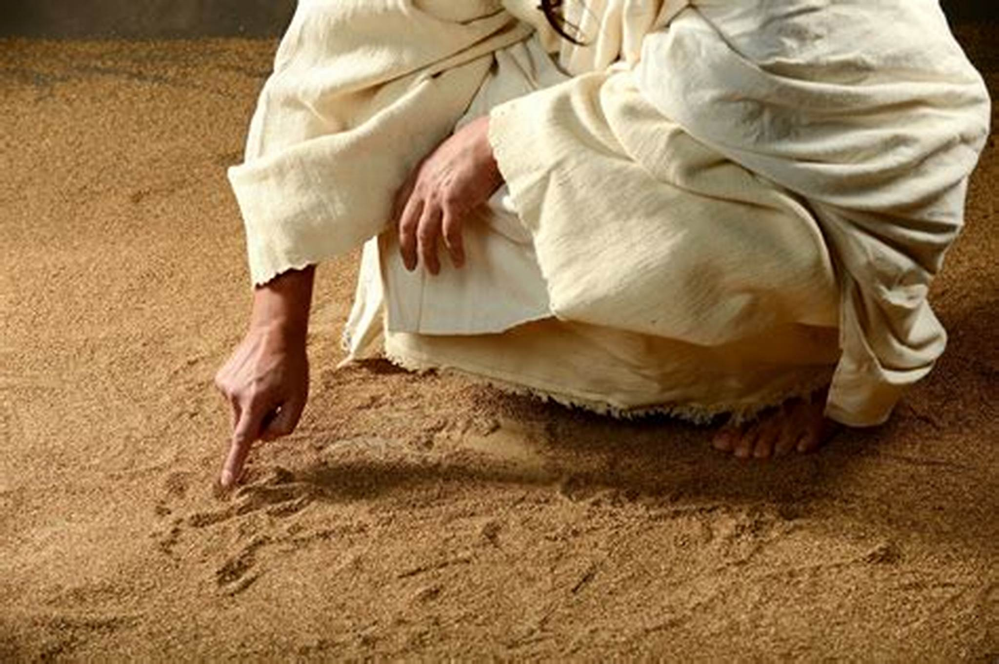
JESUS: LESSONS TO LEARN

Slide 3
Jesus: Lessons to Learn
Taught us from Parables
Healed the sick- Miracles
Resisted the Temptation of the Devil
What have I learned from Jesus?

Slide 4
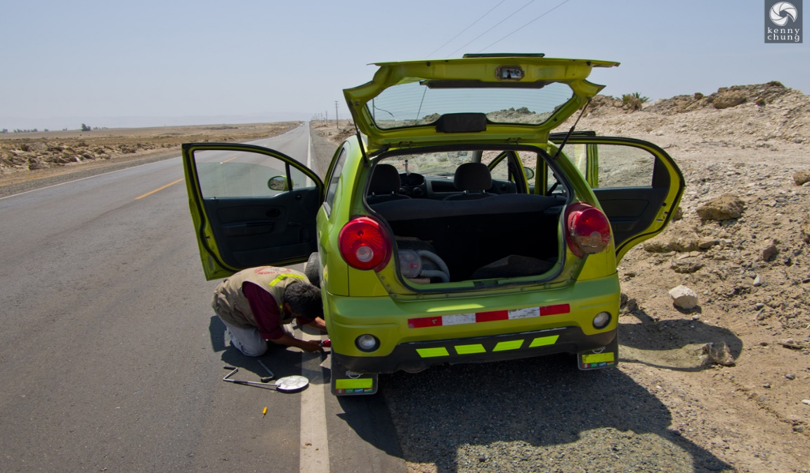
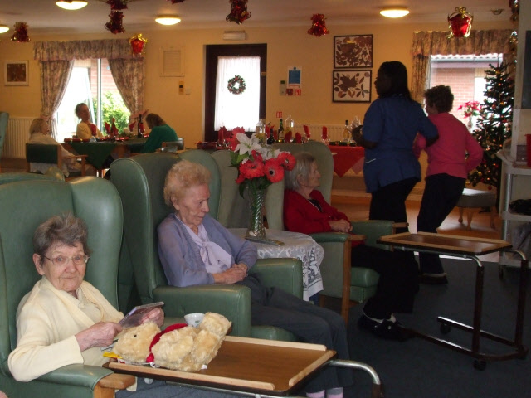
Jesus: Lesson to Learn
To Serve:
Matthew 20:28- Even as the Son of man came not to be ministered unto, but to minister, and to give his life a ransom for many.
John 13:12-16 12 So after he had washed their feet, and had taken his garments, and was set down again, he said unto them, Know ye what I have done to you?13 Ye call me Master and Lord: and ye say well; for so I am.14 If I then, your Lord and Master, have washed your feet; ye also ought to wash one another's feet.15 For I have given you an example, that ye should do as I have done to you.16 Verily, verily, I say unto you, The servant is not greater than his lord; neither he that is sent greater than he that sent him.
How Can We Serve:
Practice hospitality….. Hebrews 13:2 Be not forgetful to entertain strangers: for thereby some have entertained angels unawares.

Slide 5
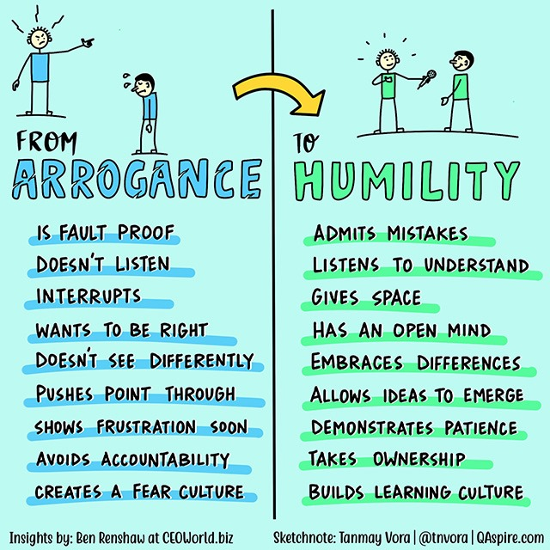
Jesus: Lesson on Humility
Philippians 2:5-8 - 5 Let this mind be in you, which was also in Christ Jesus:6 Who, being in the form of God, thought it not robbery to be equal with God:7 But made himself of no reputation, and took upon him the form of a servant, and was made in the likeness of men:8 And being found in fashion as a man, he humbled himself, and became obedient unto death, even the death of the cross.
To be Humble: often rendered as soft, no backbone, weak, not aggressive.
Pride will work against us.
Control our lips and words..
Proverbs 18:12- 12 Before destruction the heart of man is haughty, and before honour is humility.
Philippians 2:3 3 Let nothing be done through strife or vainglory; but in lowliness of mind let each esteem other better than themselves.

Slide 6
Jesus: Lesson on Prayer
Mark 1:35- ³⁵ And in the morning, rising up a great while before day, he went out, and departed into a solitary place, and there prayed.
That feeling you get when you try to call someone several times to tell them something important and they answer.
Philippians 4:6 - Be careful for nothing; but in every thing by prayer and supplication with thanksgiving let your requests be made known unto God.
Matthew 6:7 - But when ye pray, use not vain repetitions, as the heathen [do]: for they think that they shall be heard for their much speaking.
James 5:16 - Confess [your] faults one to another, and pray one for another, that ye may be healed. The effectual fervent prayer of a righteous man availeth much.
Peace, comfort, health, enemies

Slide 7
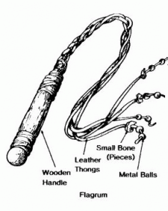
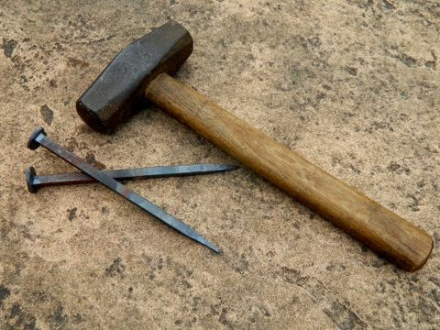
Jesus: Lesson on Sacrifice
I John 2:2 “And he is the propitiation for our sins: and not for ours only, but also for the sins of the whole world.”

Slide 8
Jesus: Lesson on Love and Sacrifice
Sacrifice- the surrender or destruction of something prized or desirable for the sake of something considered as having a higher or more pressing claim.
Family, Time, Self, Possessions, money
Matthew 10:37 He that loveth father or mother more than me is not worthy of me: and he that loveth son or daughter more than me is not worthy of me.
I John 2:17 And the world passeth away, and the lust thereof: but he that doeth the will of God abideth for ever.

Slide 9
Who Jesus is to ME?

