Slide 1
Only here for a little while
It is even a vapor that appears for a little time and then vanishes away. James 4:14b.

Slide 2
Scripture Reading
1 Samuel 20: 1-4 20 Then David fled from Naioth in Ramah, and went and said to Jonathan, “What have I done? What is my iniquity, and what is my sin before your father, that he seeks my life?”
² So Jonathan said to him, “By no means! You shall not die! Indeed, my father will do nothing either great or small without first telling me. And why should my father hide this thing from me? It is not so!”
³ Then David took an oath again, and said, “Your father certainly knows that I have found favor in your eyes, and he has said, ‘Do not let Jonathan know this, lest he be grieved.’ But truly, as the Lord lives and as your soul lives, there is but a step between me and death.”
⁴ So Jonathan said to David, “Whatever you yourself desire, I will do it for you.

Slide 3
Only HERE FOR A LITTLE WHILE
We will see our life from different perspectives each year, month and day that we live.
Songs: Time in a bottle- Cat’s in the Cradle- Time marches on-
OUR LIFE- DOESN’T STAND STILL.. WE MAY.. BUT IT MOVES FORWARD

Slide 4
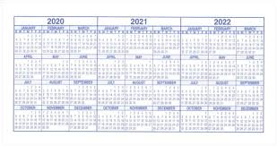
Years
Go fleeting by: ask your grandparents or parents…
for god:
2 Peter 3:8 - But, beloved, do not forget this one thing, that with the Lord one day is as a thousand years, and a thousand years as one day.
How important is a year of your life?
Look forward- Exodus 21:2- If you buy a Hebrew servant, he shall serve six years; and in the seventh he shall go out free and pay nothing.
Worth every day- Genesis 29:20- ”So Jacob served seven years for Rachel, and they seemed only a few days to him because of the love he had for her.”
Where are you with god?
Exodus 16:35- And the children of Israel ate manna forty years, until they came to an inhabited land; they ate manna until they came to the border of the land of Canaan.
Do you remember the good or bad years?

Slide 5
m.o.n.t.h
February- Bad weather and license plate renewal….
EACH M.O.N.T.H?
Mites- Mark 12:42- Then one poor widow came and threw in two mites, which make a quadrans.
Obedient- Titus 3:1- Remind believers to submit to rulers and authorities, to be obedient, and to be ready to do any honorable kind of work.
Neglect- Hebrews 2:3- how shall we escape if we neglect so great a salvation, which at the first began to be spoken by the Lord, and was confirmed to us by those who heard Him,
Temperance- Galatians 5:23-²³ Meekness, temperance: against such there is no law.
Hairs- Matthew 10:30- ³⁰ But the very hairs of your head are all numbered.
God knows us better than anyone, even ourselves… who can give me better care..

Slide 6
today
Today is the day…You arrived…. You get to go… it’s my turn..
Hebrews 3:13- ¹³ but exhort one another daily, while it is called “Today,” lest any of you be hardened through the deceitfulness of sin.
Luke 23:43- ⁴³ And Jesus said to him, “Assuredly, I say to you, today you will be with Me in Paradise.”
Luke 4:21- And He began to say to them, “Today this Scripture is fulfilled in your hearing.”
God has given you this moment.. What will you do with “today”?
2 Cor. 6:2- ² For He says: “In an acceptable time I have heard you, And in the day of salvation I have helped you.” Behold, now is the accepted time; behold, now is the day of salvation.

Slide 7
tomorrow
Vacation- surgery-weather
Solomon warns us:
Proverbs 27:1- Do not boast about tomorrow, For you do not know what a day may bring forth.
One today can change our tomorrow forever..
It is good to plan but We should never build our lives on tomorrow.
James 4:14A- ¹⁴ whereas you do not know what will happen tomorrow. For what is your life?

Slide 8
Brevity of Life
Psalm 90:10- The days of our lives are seventy years; And if by reason of strength they are eighty years, Yet their boast is only labor and sorrow; For it is soon cut off, and we fly away.
My life
Our Life 70 Years | Years | Months | Weeks | Days
Lily | 61 | 732 | 3172 | 22265
Sydney | 50 | 600 | 2600 | 18250
Megan | 34 | 408 | 1768 | 12410
Ty | 20 | 240 | 1038 | 7280

Slide 9
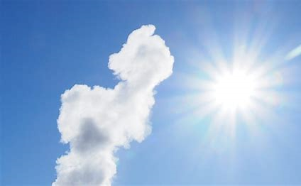
Today I stood singin' songs and sayin' Amen
Saying goodbye to an old friend who seemed so young
He spent his life workin' hard to chase a dollar
Putting off until tomorrow the things he should have done
Made me start thinking "What's the hurry, why the runnin'?
I don't like what I'm becoming, gonna change my style
Take my time and I take it all for granted"
'Cause we're only here for a little while
Gonna hold who needs holdin'
Mend what needs mendin'
Walk what needs walkin'
Though it means an extra mile
Pray what needs prayin'
Say what needs sayin'
'Cause we're only here for a little while

